Slide 1
Microsoft Power Virtual Agents in a Day
Speaker Name
Please share your feedback
aka.ms/PVAiaDSurvey

Slide 2
Agenda
Module | ID | Name | Length
Overview & Setup | 1 | Introductions | 20 minutes
 | 2 | Build your first chatbot | 30 minutes
Module 1 Power Virtual Agents | 3 | Create topics from existing webpages | 15 minutes
 | 4 | Improve your chatbot using entities, variables and topic redirects | 40 minutes
 | 5 | Integrate with prebuilt Power Automate flows | 40 minutes
Module 2 Power Automate & other integrations | 6 | Build Power Automate flows for your chatbot | 35 minutes
 | 7 | Authentication | 40 minutes
 | 8 | Hand off to support agent– no lab | 5 minutes
 | 9 | Exporting and importing a chatbot | 30 minutes
Module 3 Power Platform & Teams | 10 | Create a chatbot in Microsoft Teams Power Virtual Agents Licensing and Subscriptions | 60 minutes
 | 11 | Chatbot topic design | 20 minutes
 | 12 | Best practices for writing topic trigger phrases – no lab | 20 minutes
Module 4 Optimization | 13 | Chatbot conversation style– no lab | 20 minutes
 | 14 | Analytics, monitoring and chatbot performance improvement– no lab | 10 minutes
 | 15 | Closing | 10 minutes
Notes:
Here’s the agenda of what we are going to cover today
Once we have done the overview and setup, the content is divided into 3 modules:
Creating your chatbot (Module 1)
Power Automate and other integrations (Module 2)
Topic design, optimizing your bot, and analytics (Module 3)
Note that there are not labs for every section – there are no labs for 8, 12-14

Slide 3
Introductions (Instructor)
Notes:
Use this slide to introduce yourself and add contact details

Slide 4
Introductions (Participants)
What’s your name?
Which company/group do you represent?
Which city/country do you live in?
What is your role?
What are your expectations from this training?
Notes:
Optional slide to ask participants to introduce themselves.

Slide 5
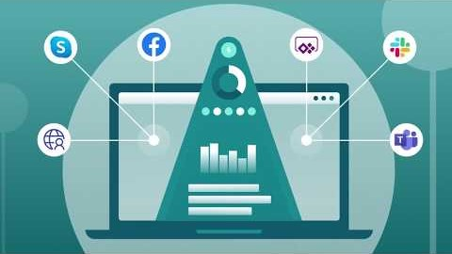
Engage customers with Microsoft's Power Virtual Agents
Notes:
This slide contains a link to a YouTube video giving an overview of Power Virtual Agents.

Slide 6

POWER VIRTUAL AGENTS
Intelligent Chatbots
Empower your people to drive more business value through easy to create natural, conversational AI
Notes:
Power Virtual Agents empowers your people to drive more business value through easy to create natural, conversational AI.
There aren’t enough professional developers to create the huge number of applications and chatbots that are needed right now. Power Virtual Agents provides a no-code graphical user interface that democratizes chatbot technology, making it possible for anyone to build a chatbot, no special skills needed, and greatly reducing the time and cost involved in deploying a chatbot.

Slide 7






Microsoft Power Platform
The low-code platform that spans Office 365, Azure, Dynamics 365, and standalone applications
Innovation anywhere. Unlocks value everywhere.
Power BI
Business analytics
Power Apps
Application development
Power Automate
Process automation
Power Virtual Agents
Intelligent chatbots
Data connectors
Portals
AI Builder
Microsoft Dataverse
Notes:
The Power Platform is the single low code platform across all of Microsoft, for Office 365, Dynamics 365, and Azure as well as your standalone applications
It includes 4 incredibly strong individual products
Power BI for analyzing data
Power Apps for creating web and mobile applications without having to write any code
Power Automate for robotic process automation and digital process automation
Power Virtual Agents to create chatbots without having to write code, host VMs or manage infrastructure
All this is powered by common components like Microsoft Dataverse, AI Builder and the data connectors.
You have a single integrated solution to solve enterprise application development needs in a rapid way – whether it’s professional developer, IT professional, citizen developer or business user in the company.
Take action based on your data driven decision, use Power Apps, Power Automate and Power Virtual Agent
Analyze | Make sense of your data through interactive, real-time dashboards and unlock the insights needed to drive your business forward
Act | Build apps in hours—not months—that easily connect to data, use Excel-like expressions to add logic, and run on the web, iOS, and Android devices
Automate | Include powerful workflow automation directly in your apps with a no-code approach that connects to hundreds of popular apps and services add virtual bots to automate your service and communication, using Power Virtual Agents
Power Platform enables everyone to be working together, using your data to help EVERYONE, from the CEO to the front-line workers, drive the business decision with data and enables innovation.

Slide 8
Complex challenges
66%
90%
59%
try to use self-service first rather than contacting an agent for assistance¹
of customers expect consistency and continuity across channels²
of channels are managed in silos³
Global State of Customer Service, Microsoft
Aberdeen: Empowered Customers Demand a Seamless Experience
Dimension Data: 2017 Global Customer Experience Benchmarking Report
Notes:
Here are some figures about the current reality. Organizations are going through complex challenges.
66% of customers try to use self-service first before contacting an agent. Why? Because contacting an agent takes a long time, you end up in a queue, when you just want an answer straight away
90% of customers expect consistency across channels – on the phone, website, retail store – they want the same treatment.
59% of the channels are managed in silos. Call centres have different incentives than retail stores, the website is managed separately and so on.

Slide 9
Chatbots can help, but…
Bots are hard to create and expensive to maintain
There is impedance between the subject matter experts with answers – and the developers and scientists who create bots
Bots aren’t useful unless they can integrate with the backend and provide personalized answers
Notes:
Chatbots can help address all these challenges
However the problem with chatbots is that they are hard to create and expensive to maintain.
Why? Because you need to put a lot of technical infrastructure up front and then a lot of effort in to creating the content as well.
There is also friction between the subject matter experts and the developers and data scientists / AI specialists when you create the bot.
And finally if you cannot create a bot that can act on behalf of the customer or connect you back to your systems it’s not as useful as it should be.

Slide 10
OUR VISION Power Virtual Agents
ENGAGE NATURALLY
DEMOCRATIZE AI
CONTINUOUSLY Enhance
Empower every organization to easily provide delightful, natural interactions with their customers and improve engagement and outcomes
TAKE ACTION
Notes:
Here is the vision for Power Virtual Agents:
Engage Naturally: Create really natural conversations. Engage with your customers and employees conversationally. Resolve routine issues easily, freeing up staff to focus on complex matters.
Democratize AI: Empower your subject matter experts to easily create powerful bots using a guided no-code graphical interface. No need for developers or data scientists. The best software engineers and data scientists have created an easy to configure platform, they have taken care of that, so you just focus on your business
Continuously Enhance: Improve the model and the experience. Point the AI to your website and automatically build topics to get started with a few clicks. As the bot gets used, powerful metrics and insights help tell you what topics to build next.
Take Action: Connect to your backend systems with a few clicks or using the hundreds of connectors that come with the Power Platform. A bot that can provide an answer is great, but a bot that can provide an answer and act on behalf of the customer, like a concierge, is even better.

Slide 11
Power Virtual Agents is designed for everyone
The chatbot service that enhances everyone’s experience
Your Customers
Subject Matter Experts
IT Admin/Dev
Notes:
Power Virtual Agents is designed with customer centricity in mind. Your customers could be external, or internal (your employees)
Subject Matter Experts can build conversational flows using a very easy interface, with no code.
IT Developers and Admins can help SMEs to build conversational flows and integrate their chatbots with line of business applications, using low code Power Automate tools.
There is no need for data scientists and no need to build AI or ML models.

Slide 12
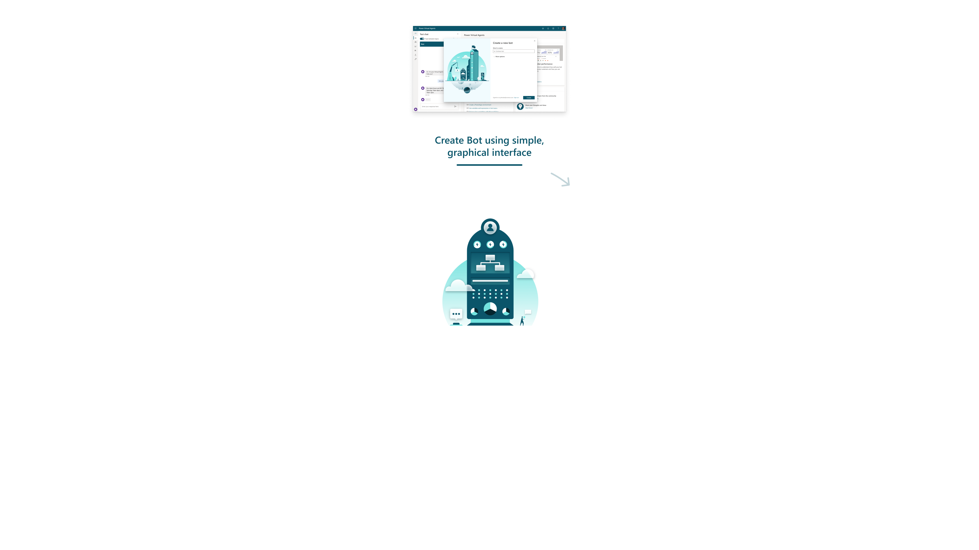


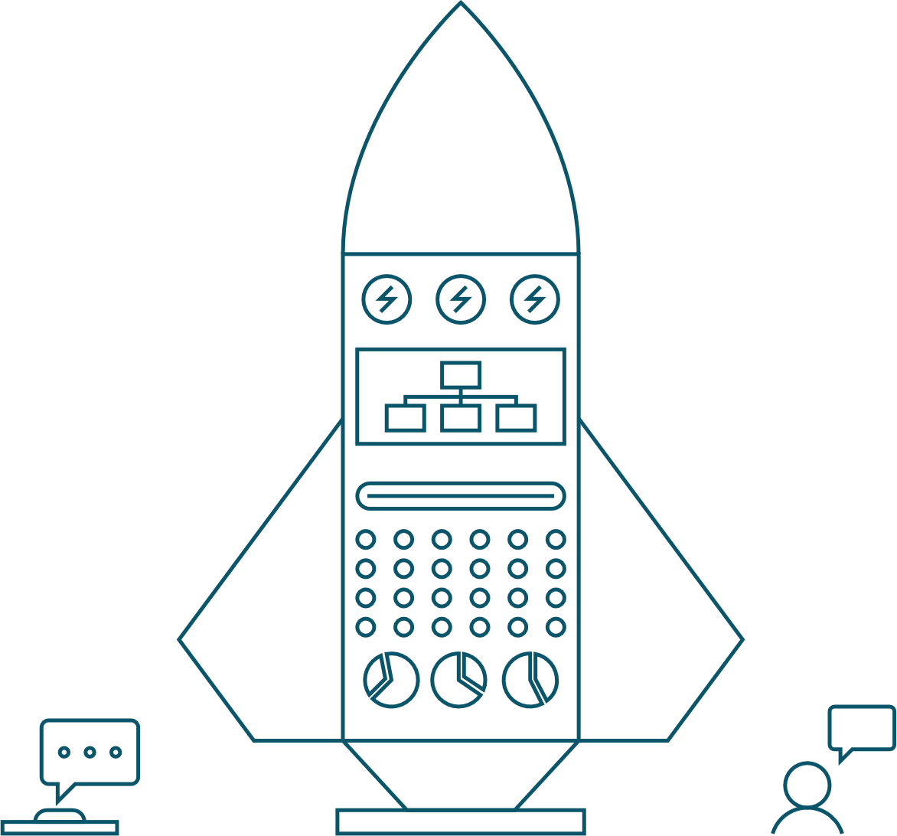




Power Virtual Agents Lifecycle
Create Bot using simple, graphical interface
Monitor Bot performance and improve
Get starter topics to build upon (from FAQs, sites, etc)
Public Bot to BF channels
Author topics with NL, slot extraction, variables, etc
Extend Bot with BF Skills for complex scenarios
Integrate Bot with backend APIs using MS Flow
Notes:
Creating a bot is an easy step by step process. Each chatbot also has performance analytics to enable a feedback loop so you can continuously and easily enhance your chatbot to optimize the customer experience.

Slide 13
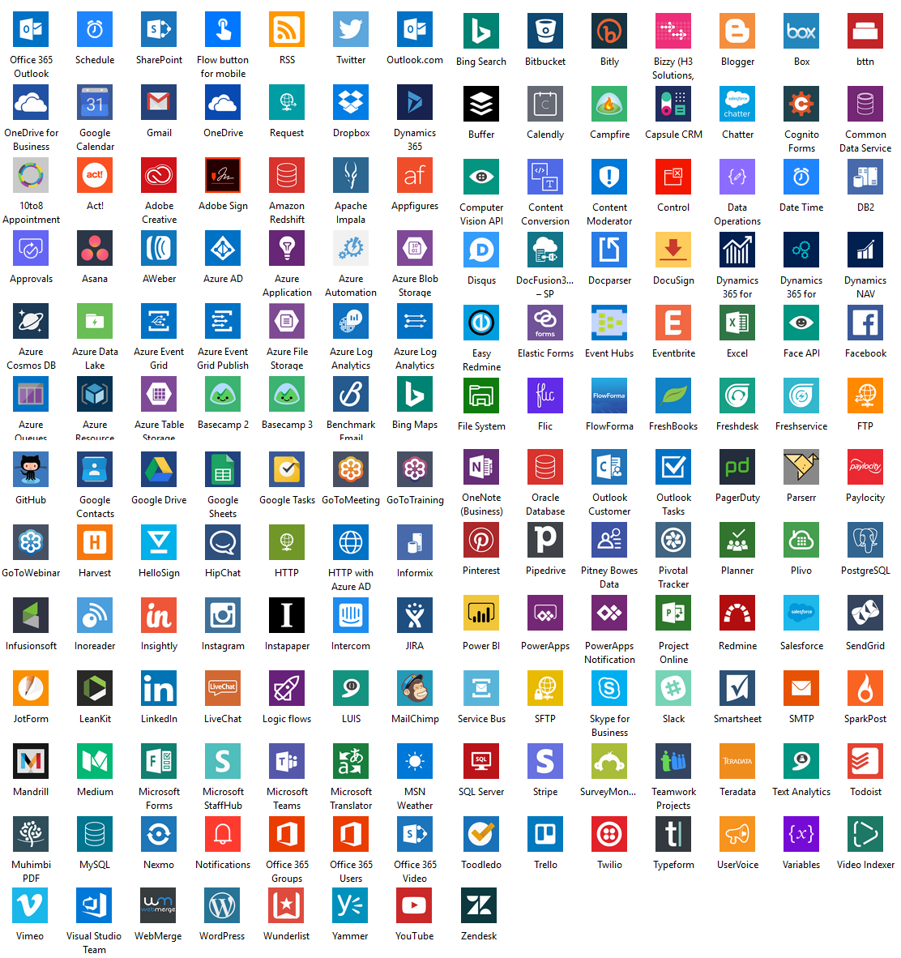

Built on Power Platform & Bot Framework
Power Virtual Agents
Power Platform
The full power of our low code platform optimized for business users. Use 100s of pre-built connectors or use Flows to call custom APIs
Bot Framework
Easy, no-cliff access to all the capabilities of Microsoft Bot Framework
Azure & Cognitive Services
Integrated with Azure Cognitive Services
Notes:
Power Virtual Agents is built on the Power Platform. It is also built on the Microsoft Bot Framework.
You can extend and personalize your chatbot using Power Platform tools (Power Automate) or leverage the capability of Bot Framework skills. Bot Skills are reusable conversational dialogs that can be used to author scenarios using complex capabilities. Bot authors can convert any existing bot into a Skill and seamlessly trigger actions embedded in it through the Power Virtual Agents no-code designer. You benefit from a no-cliffs experience - if you want to go beyond what you can do with Power Platform, you can extend limitlessly with Bot Framework Skills.
As with any application, you can choose between PaaS and SaaS approaches when creating bot solutions. With Microsoft you can choose PaaS, SaaS, or both.
The Microsoft Bot Framework is an open source SDK & tooling optimized for bot developers.
Power Virtual Agents is a no-code SaaS offering that is optimized for the business experts in your organization.

Slide 14
SECTION SUMMARY
Power Virtual Agents helps support industry trends
Engage Naturally
Democratize AI
Continuously Enhance
Take Action
Designed for Multiple Personas
Customer Focused, Connected, Extensible
Developed on the Microsoft Bot Framework

Slide 15
Lab 01:
Prerequisites – Create environment and import solution package

Slide 16
Build your first chatbot

Slide 17
PVA Information Architecture
Microsoft Dataverse Environment
PVA BOT (0, 1 or more bots in an environment)
User Topics (1 or more in a bot)
System Topics (8 pre-defined in a bot)
Conversation Tree (1 per topic)
Trigger Phrases
Conversation tree
Trigger Phrases
(read only in system Topics)
Prebuilt Entities
Custom Entities
Prebuilt Entities
Custom Entities
Power Automate Flows
Bot Framework Skills
Power Automate Flows
Bot Framework Skills
Notes:
You can have one or more bots in your Microsoft Dataverse Environment.
It’s common to have 25+ user topics within a chatbot. Within each topic you construct a conversation tree.
A conversation tree consists of trigger phrases, multiple nodes, conditions, the ability to use entities and call actions (flows or skills). Note that to use Power Automate flows in a Power Virtual Agents chatbot they must be in a solution, within the same Dataverse environment as the chatbot
You can redirect/call another user topic or system topic from within a conversation tree.
Power Virtual Agents comes with:
4 pre-defined user topics that you can use or delete. These are useful for learning or getting started
8 pre-defined system topics. Think of these as building blocks for your conversation. They include: Greeting, Goodbye, End of conversation survey etc. Recommend minimal editing only for these topics e.g., greeting message only.

Slide 18
Chatbot Creation Process overview
Test your bot
Test your bot
Publish your bot
Create new conversation
Publish your bot
Revise conversation
Measure your bot performance
Measure your bot performance
Create new topics
Revise topics
Create new bot
Revise bot
Notes:
Creating a bot is an easy step by step process.
First you sign up for Power Virtual Agents and create a new chatbot
Then create new topics with trigger phrases and build a conversational tree
Immediately you are able to test this using a test bot and a demo website that can be shared with other users
Once you are happy with what you’ve built, you can publish this bot to different channels that are made readily available by Power Virtual Agents
Each chatbot also has performance analytics to enable a feedback loop so you can continuously and easily enhance your chatbot to optimize the customer experience.
Revising your bot follows the same process.

Slide 19
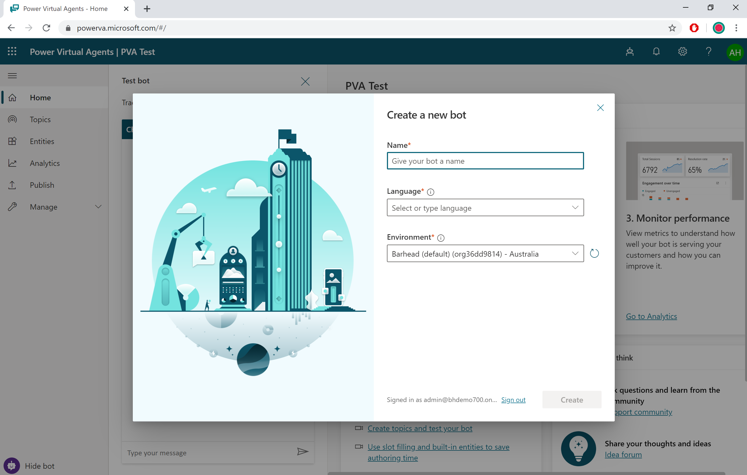
Create a new chatbot
Open the Power Virtual Agents designer
Power Virtual Agents
Select ‘new bot’
Notes:
Power Virtual Agents makes creating a chatbot very easy to do.
Open the Power Virtual Agents designer and click on the ‘bot’ icon and then select ‘new bot’.
Choose a name for your new chatbot.
Select your language
Select your Environment.

Slide 20
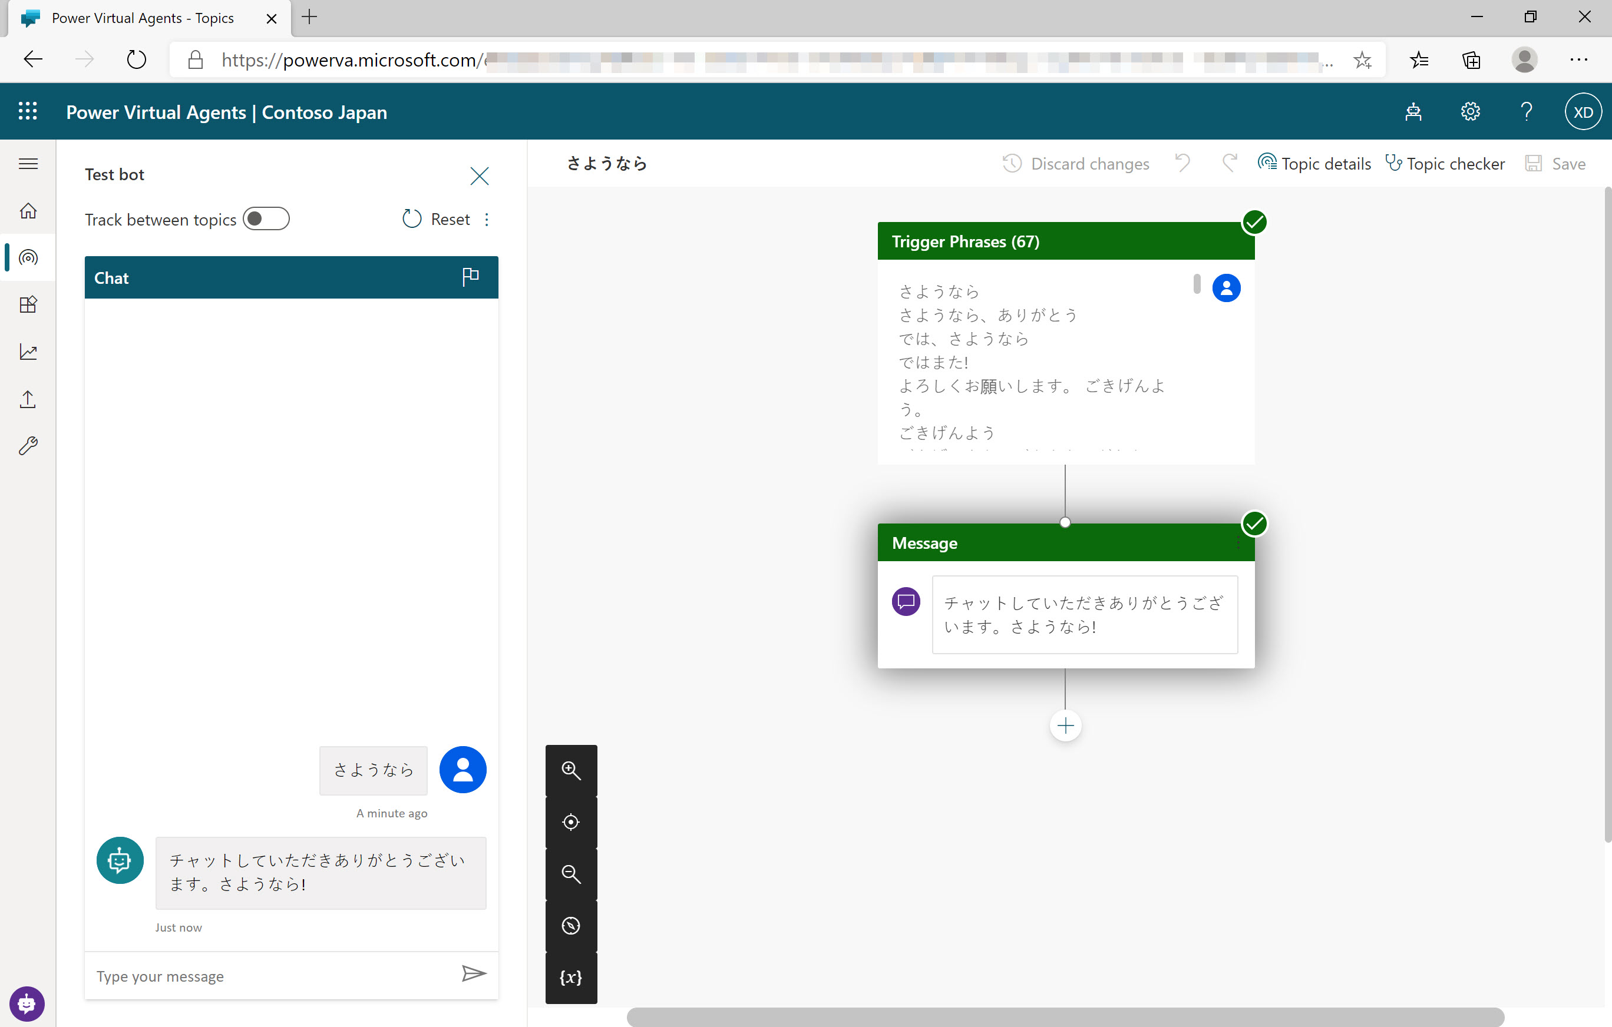
Supported Languages
Create chatbots in many different languages
Choose your language when you create your bot
Each bot speaks one language
Notes:
You can create chatbots in Power Virtual Agents in a number of languages.
Each bot speaks one language, it’s not a multilingual single bot
You specify the target language when you first create a bot
For a full list of languages supported, see: https://docs.microsoft.com/en-us/power-virtual-agents/authoring-language-support

Slide 21
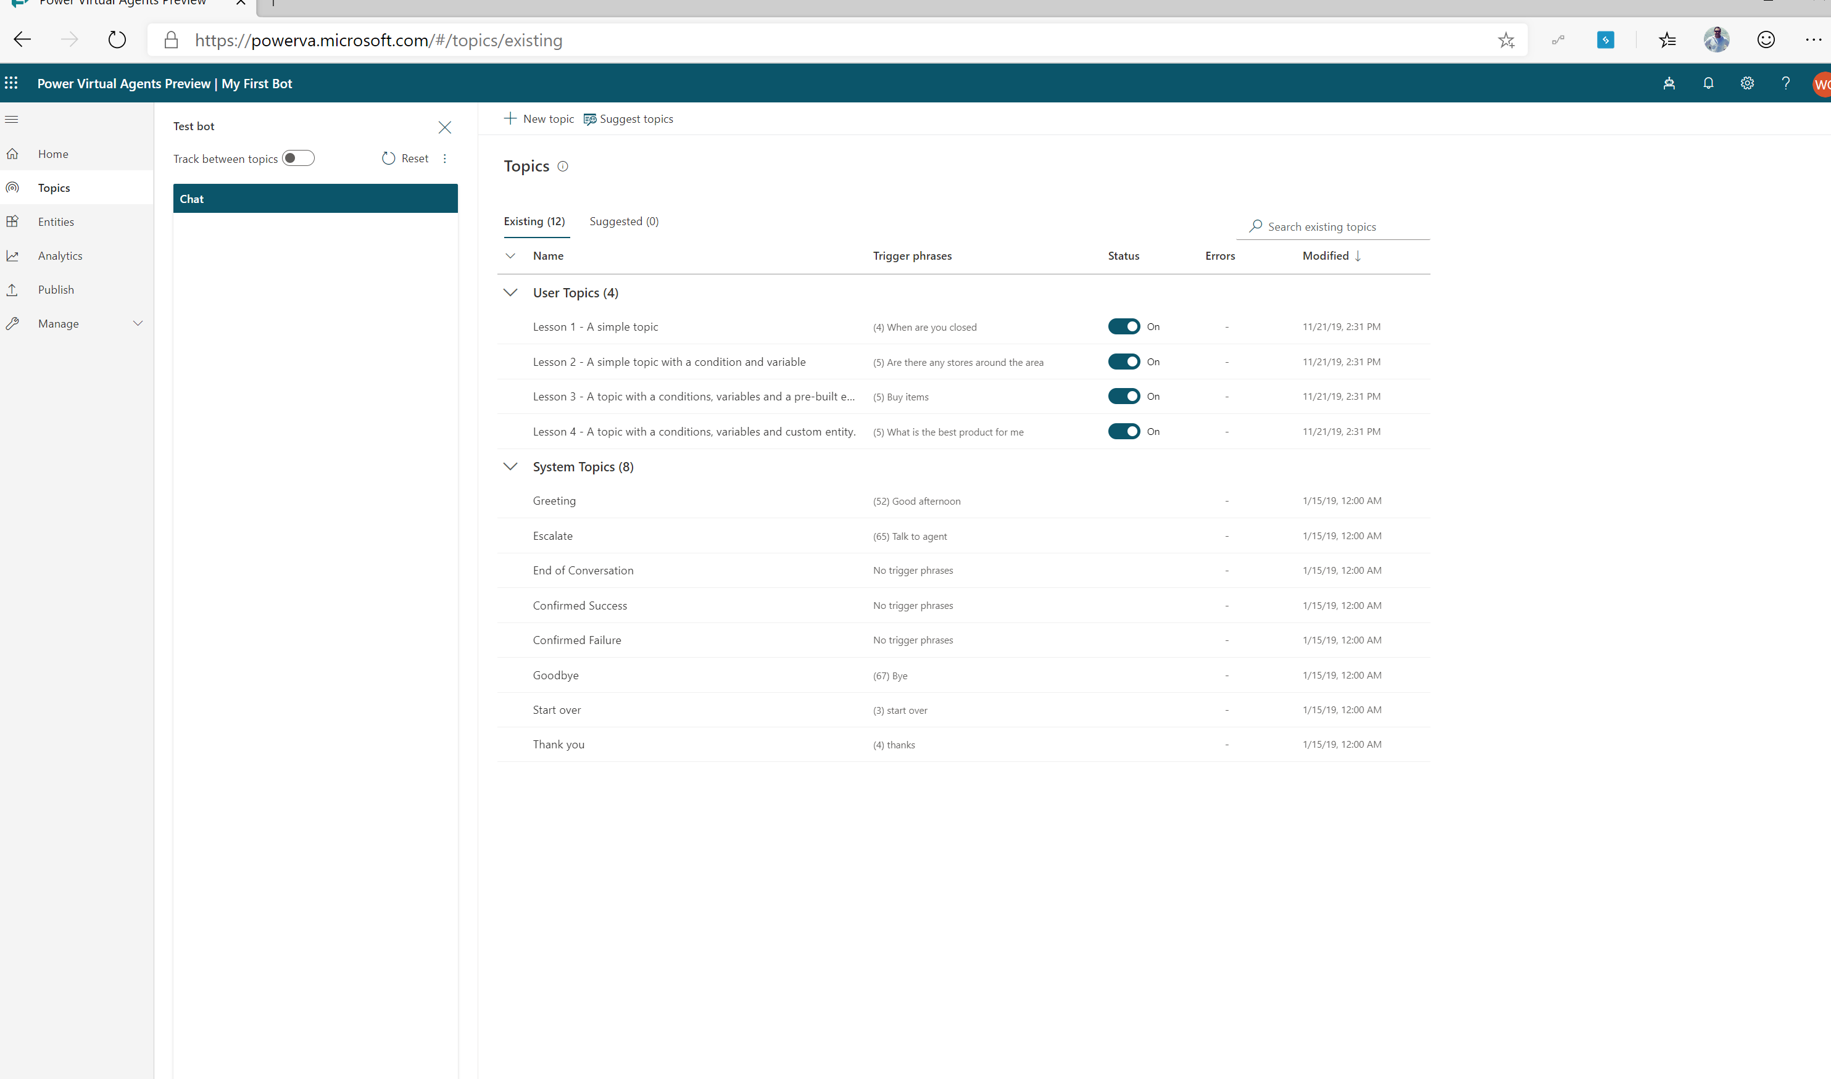
View topics
A chatbot comes with 4 User topics & 8 system topics
Using one of the 4 topics to get familiar with the structure
Notes:
When you create your chatbot, you need to decide what business scenarios you want your chatbot to address. You’ll create a topic for each scenario/question you want the bot to address.

Slide 22
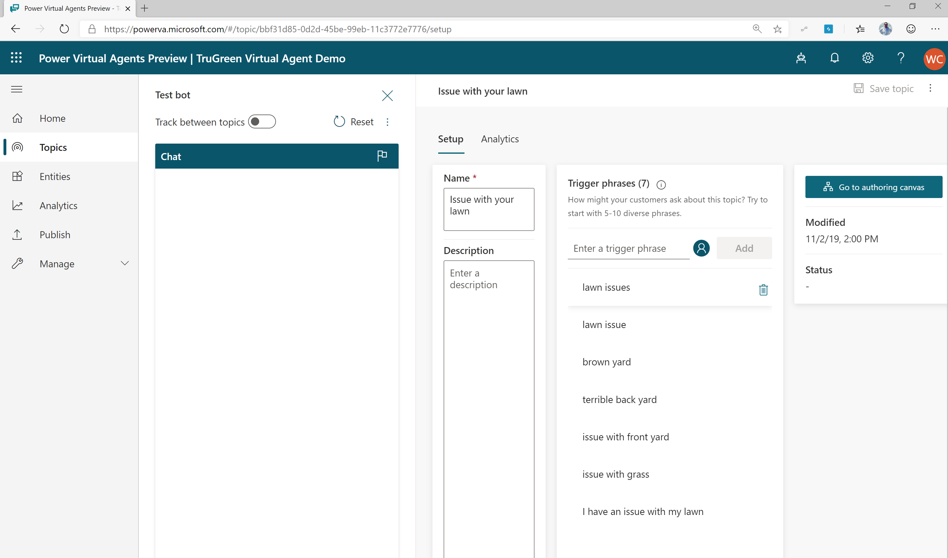
Add conversational trigger phrases
For a topic you’ll define a few trigger phrases
A trigger phrase is a way to describe an intent, it captures the way a customer might ask about a problem/issue. E.g., “problem with weeds in lawn”
You only need to provide a few sample phrases – the AI will parse whatever the user says and trigger the topic closest in meaning to the user utterance
Notes:
Your chatbot must have the appropriate trigger phrases relevant to your topic.
A topic has trigger phrases—these are phrases, keywords, or questions that a user is likely to type that is related to a specific.
The AI uses natural language understanding to parse what a customer actually types and find the most appropriate trigger phrase or node.
You should start with 5-10 trigger phrases for each topic. Your phrases should be semantically different. They don’t need to be full sentences.

Slide 23
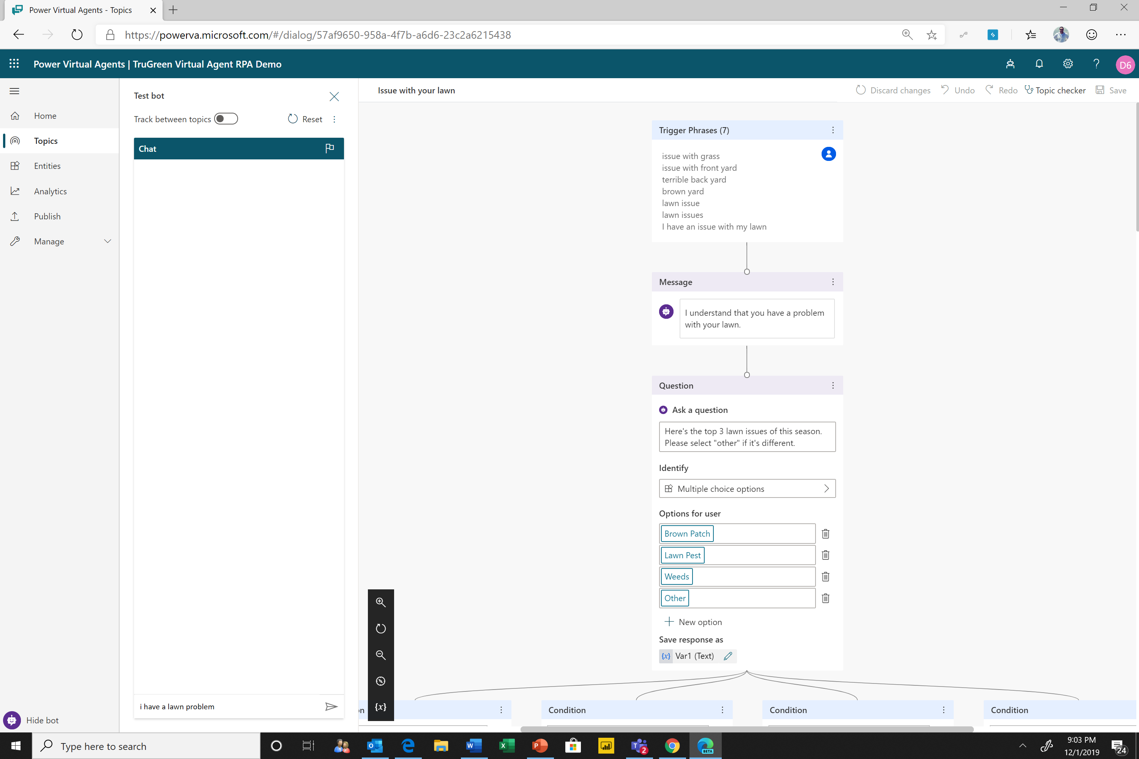
Open the authoring canvas and begin editing a topic
Open authoring canvas to view the conversation tree
You’ll see the trigger phrases at the top. You can edit the conversation tree, adding questions the bot should ask, things the bot should say etc.
Notes:
Open the authoring canvas and begin creating your chatbot. The easy to use and understand dialog tree enables any user to start creating a powerful chatbot experience.

Slide 24
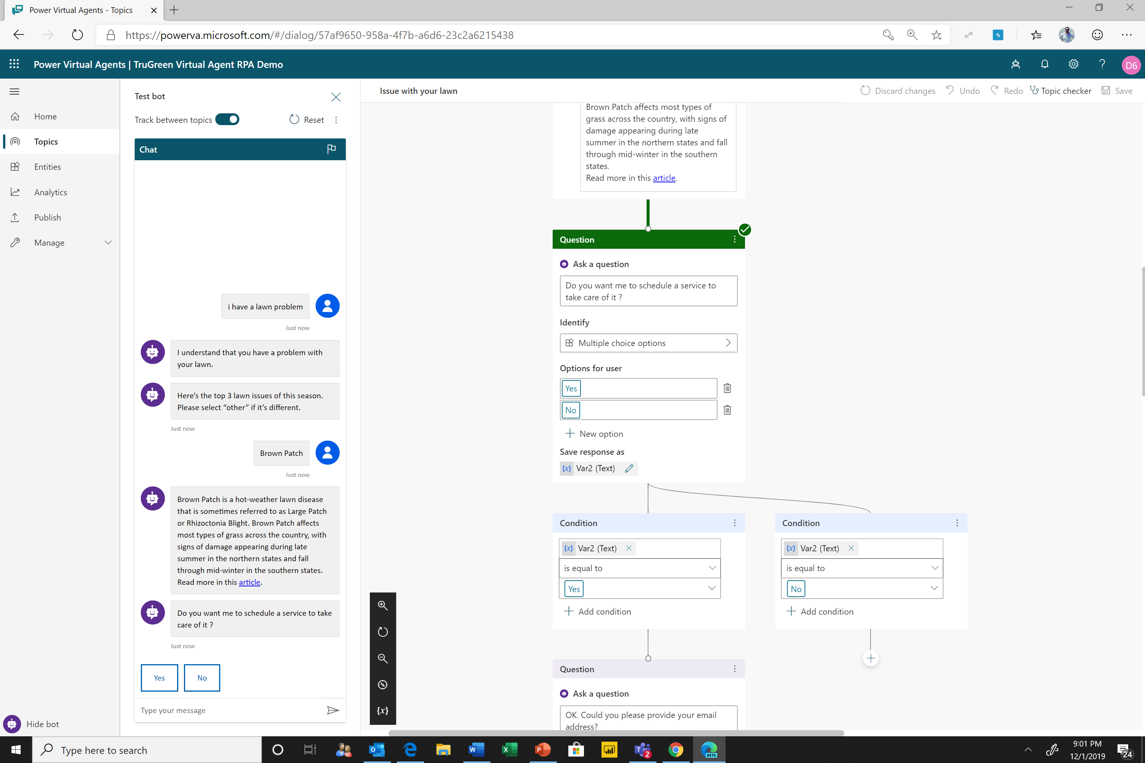
Test your topic as you construct it
To test what you’ve created click on test bot (bottom left) to expand test window
Turn on “Track between topics”. This lets you trace your way through both this topic and any others you call

Slide 25
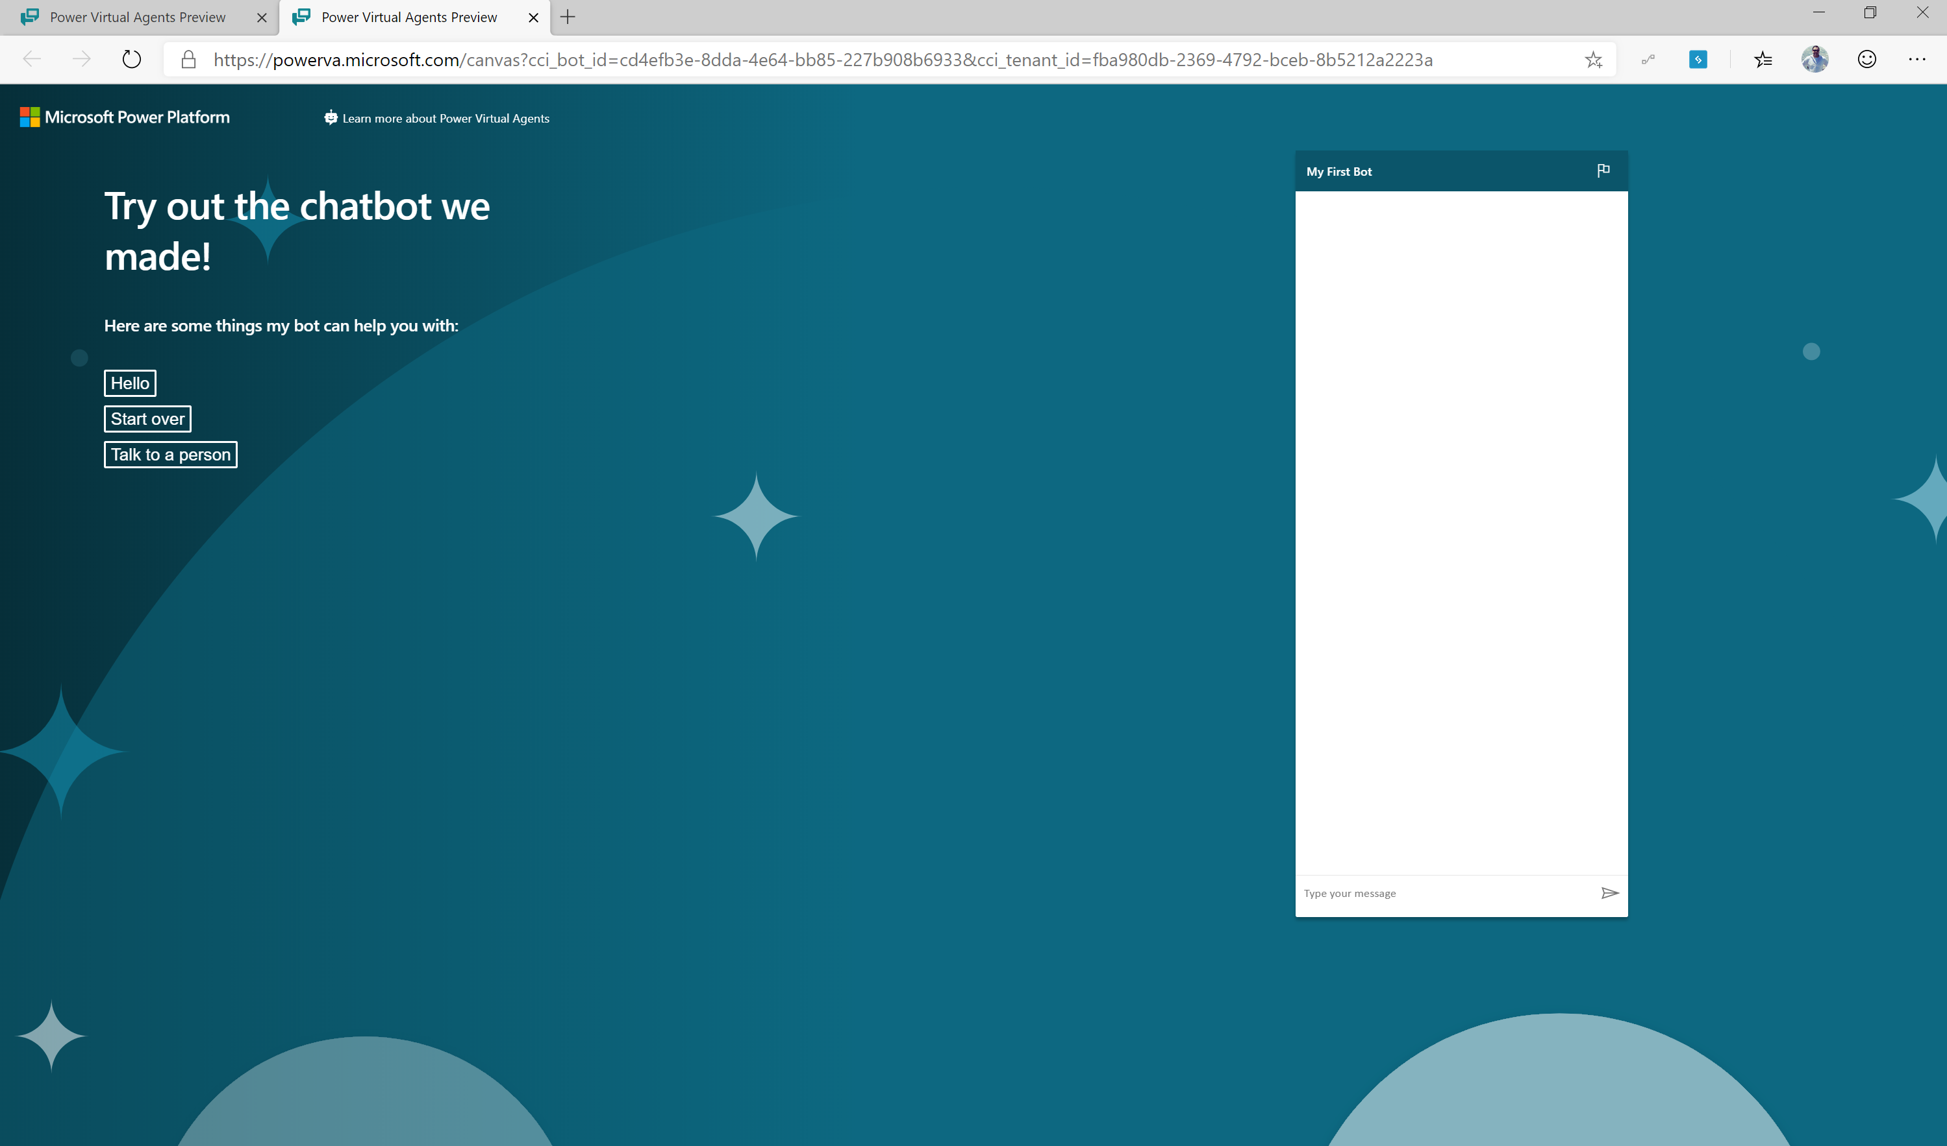
Publish to demo website
Publish to demo website and share the URL with colleagues so they can try the bot
Add screen shot with that publish to demo site show and demo page

Slide 26
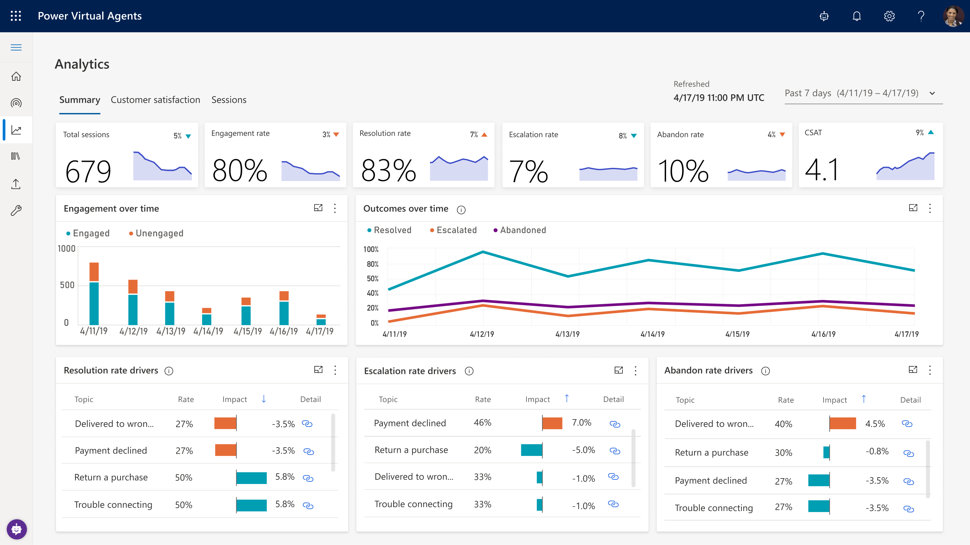
Enhance your chatbot from Analytics
GAIN VISIBILITY OF MANY PARAMETERS
Summary charts
Engagement over time chart
Session outcomes over time chart
Resolution rate drivers chart
Escalation rate drivers chart
Abandon rate drivers chart
Notes:
Easily see what’s working and what to improve
Analyze bot/customer conversations to better understand how specific topics are performing, what’s impacting your CSAT, and identify where there is room for improvement
Quickly figure out what to build next
Easily see which conversations are going to human agents and determine which topics to teach your bot next

Slide 27
SECTION SUMMARY
Power Virtual Agents enables users to create a chatbot in just minutes
Offers an easy to use designer to help create unique customer chatbot experiences
Part of the Microsoft Power Platform
Built on Microsoft Dataverse

Slide 28
Lab 02:
Build your first chatbot

Slide 29
Create topics from existing webpages

Slide 30
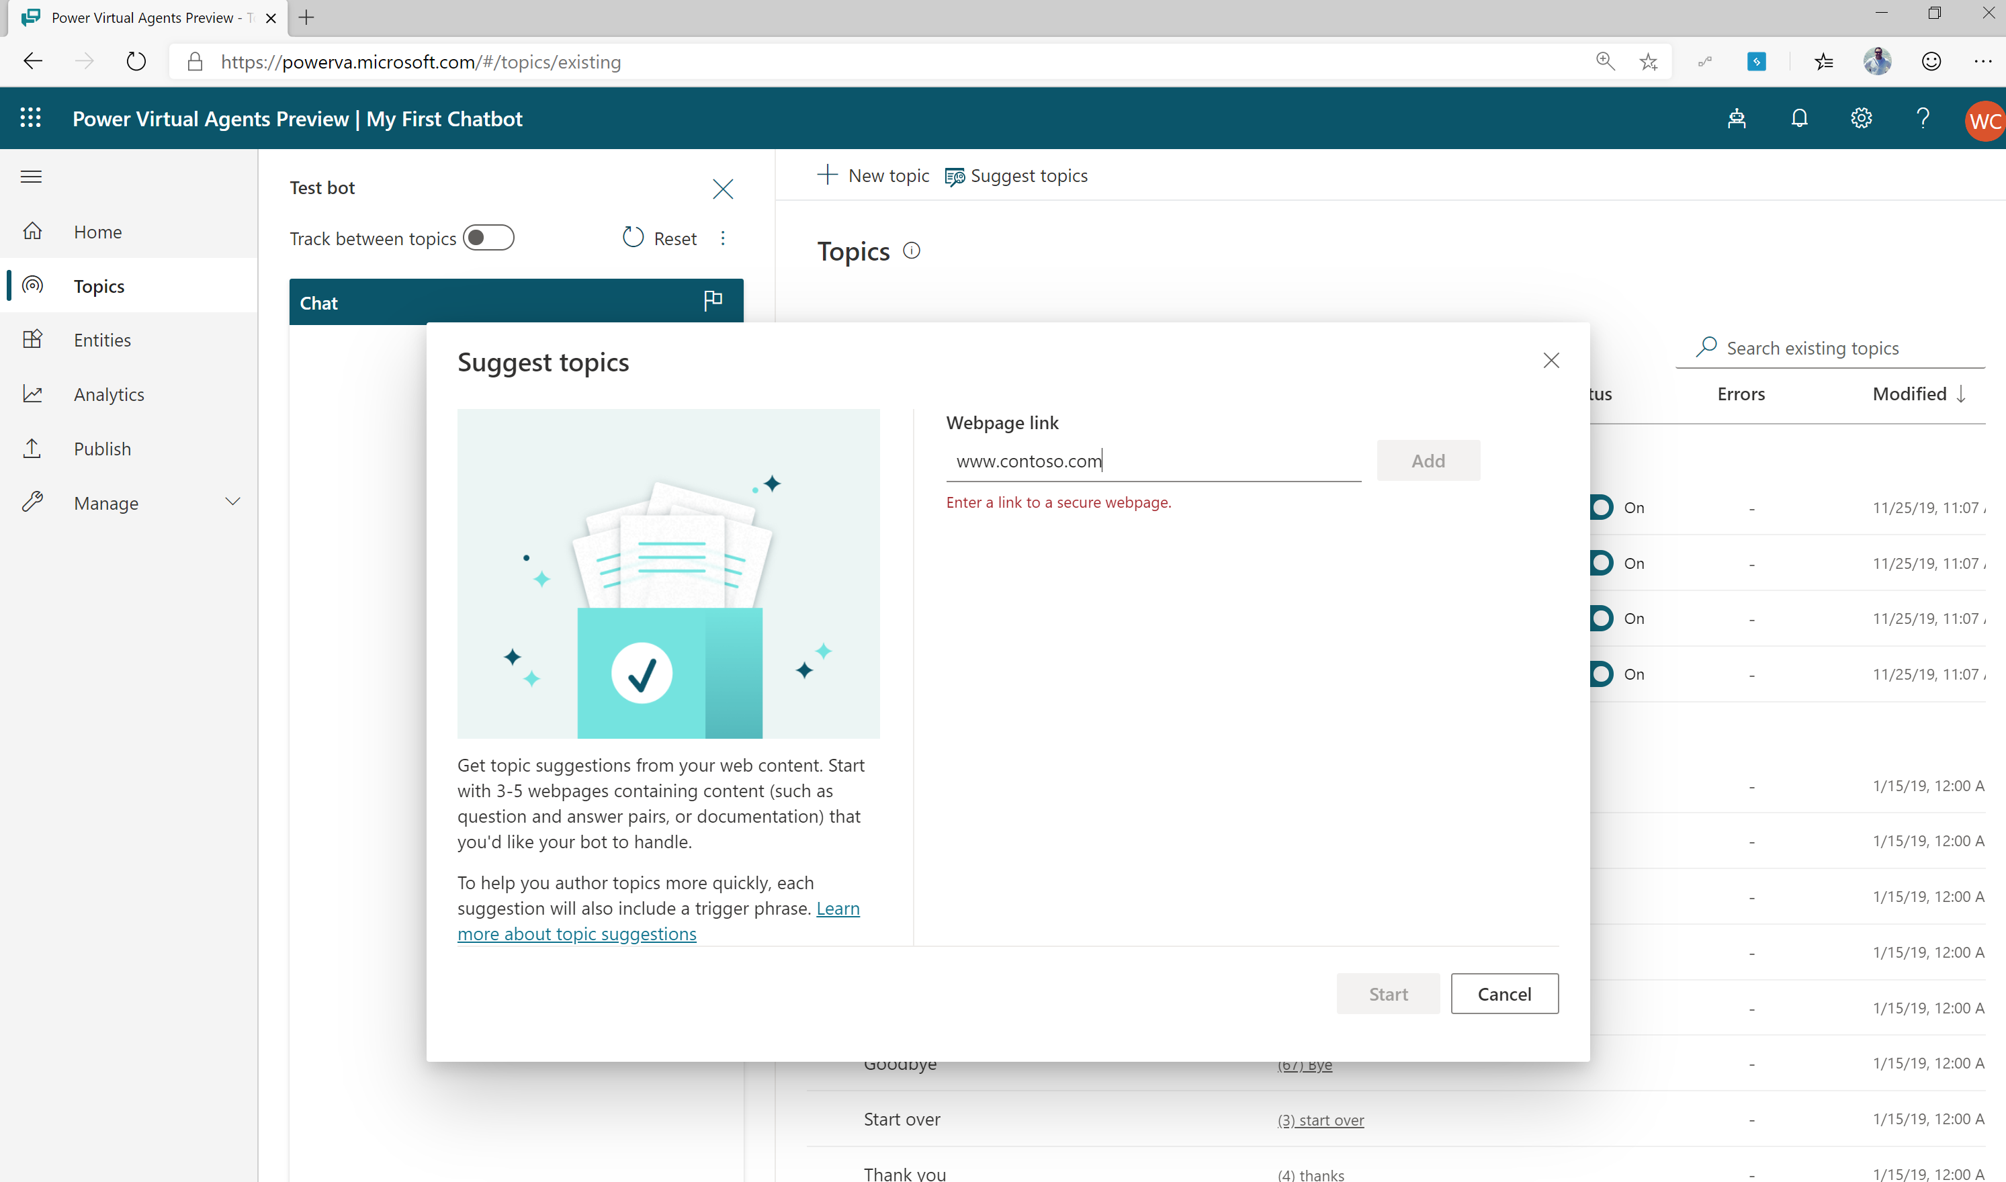
Let Microsoft AI offer you suggested FAQ chatbot topics
Each FAQ becomes a chatbot trigger
The answer to your FAQ becomes message text in dialogue tree
Create a single turn conversation tree in minutes
Notes:
Power Virtual Agents also offers suggested topics for your chatbot by leveraging Microsoft’s industry leading AI. Let Microsoft AI determine powerful potential topics which are crafted from our organization’s own web content. Elevate your customer’s awareness to topics and subjects that matter most.
The suggest topic feature allows you to point to your existing knowledge base (FAQ) webpage and have AI assisted authoring extract the relevant content for you, so you don’t have to do it manually yourself.

Slide 31
Lab 03:
Create topics from existing webpages

Slide 32
Enhance Chatbot using variables, topic redirections and entities

Slide 33
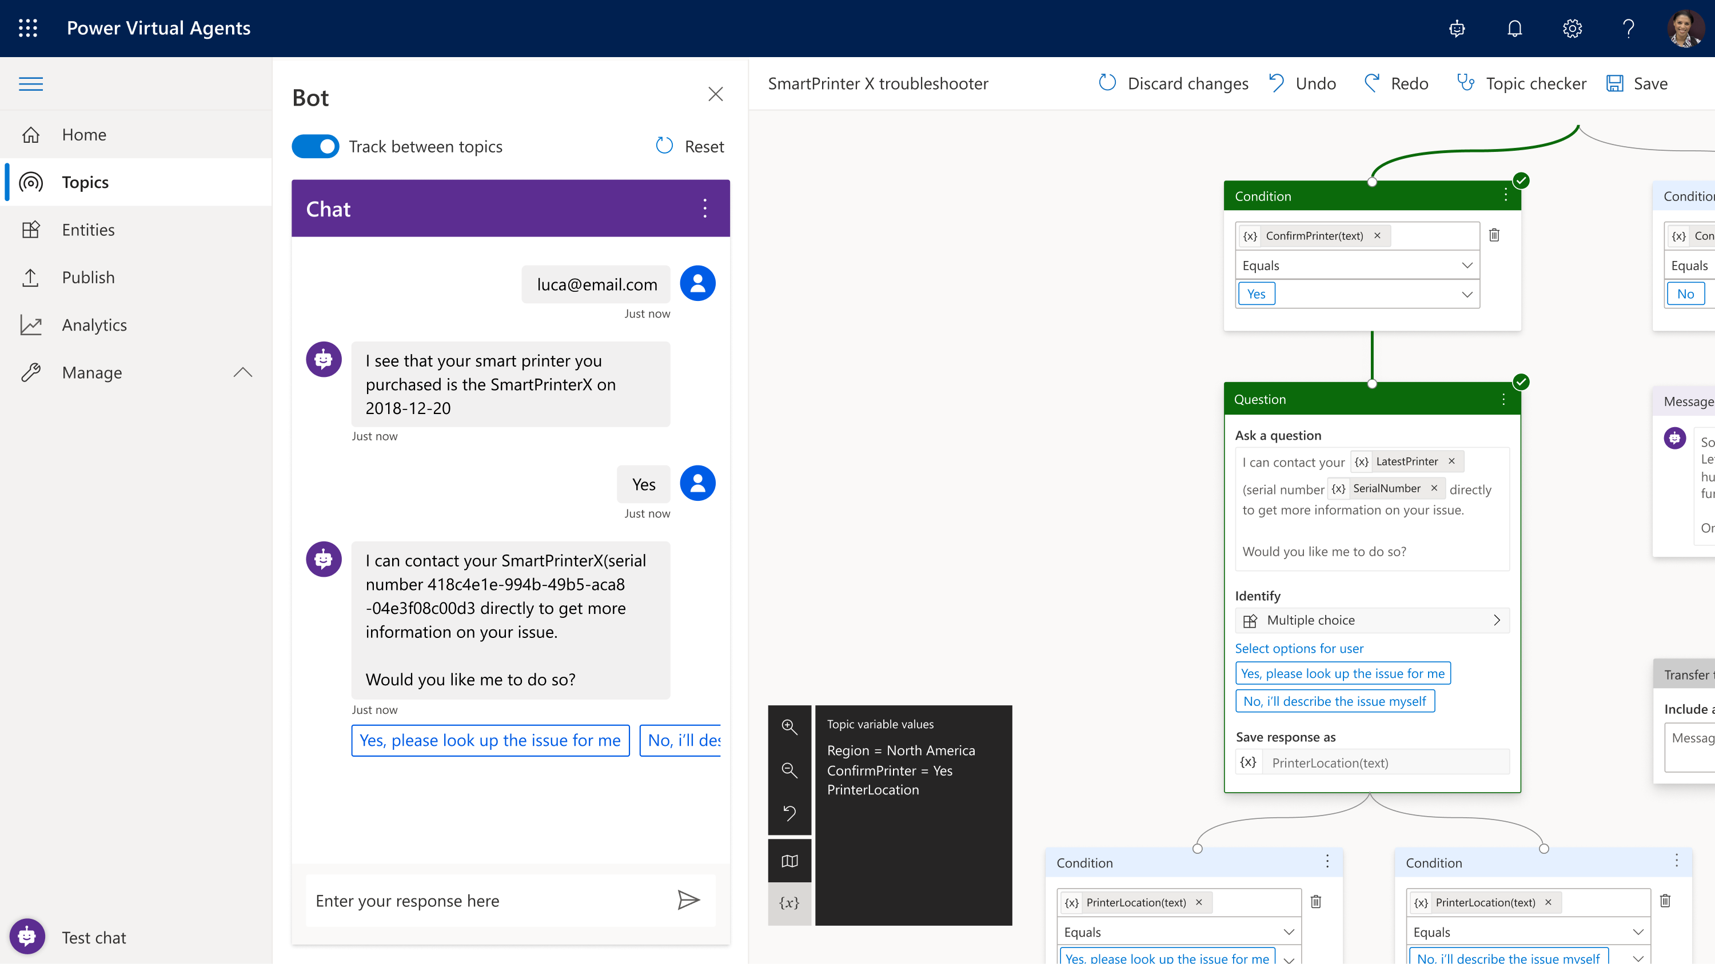
Easily create an intelligent chatbot
Simple, graphical chatbot creation and maintenance with an easy to use graphical interface.
Recognize, extract and act on dozens of common entities in user responses
Remember user responses by storing them in variables to use later
Notes:
A fundamental part of natural language understanding is to be able to identify entities in user responses. An entity is a piece of information that represents a certain type of real-world subject like a phone number, postal code, city or even a person’s name.
Out of the box, Power Virtual Agents comes with a set of pre-built entities which represent the most commonly used information types in real world dialogs, such as age, colors, numbers and names. For instance, if you use the color entity, and the user says – “I want a red car” – it knows that red is a color in that phrase. With the knowledge granted by entities, a chatbot can smartly recognize information from a user input and save it in a variable for later use.
In some cases, you will need to build a chatbot for a specific domain, and you will need to teach the language understanding model some specific knowledge – for instance, products in your store. You can do this by creating a custom entity and give the bot knowledge of that specific language used in your domain.

Slide 34
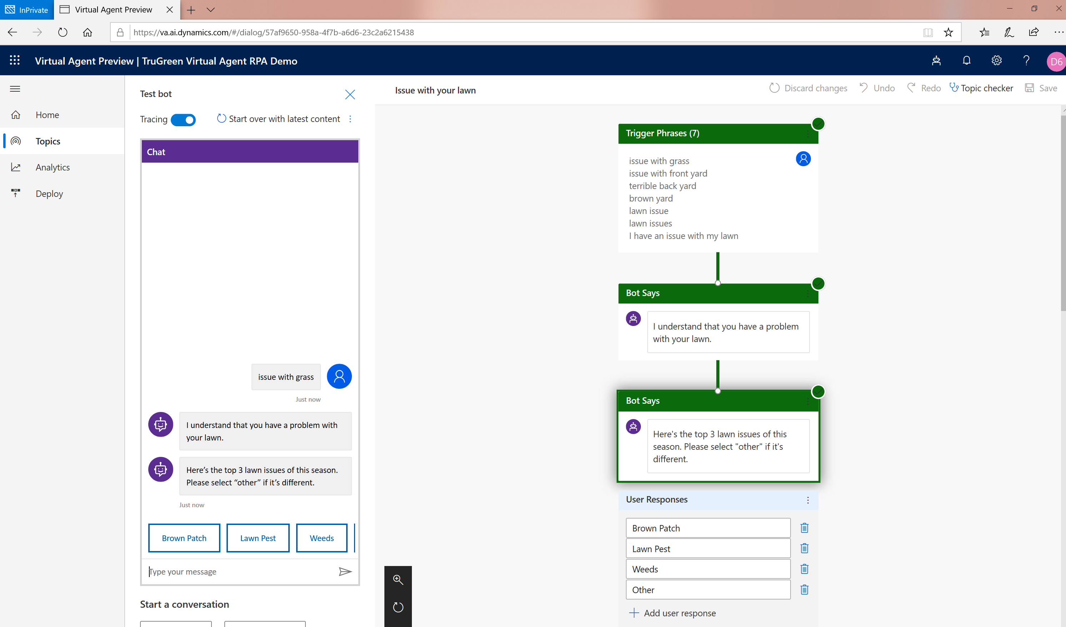
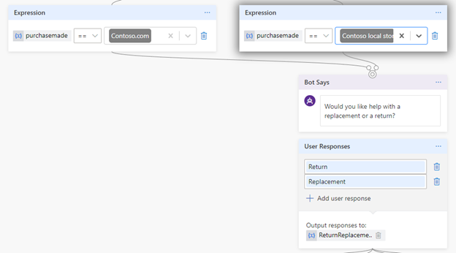
Use variables to navigate customers to tailored content
Direct your customers to content you want them to see
Power Virtual Agents
Add variables to keep customer information for later in the conversation
Notes:
Variables let you save responses from your customers in a conversation with your bot so that you can reuse them later in the conversation.
For example, you can save a customer's name in a variable called UserName. The bot can then address the customer by name as the conversation continues.
You can use variables to create logical expressions that dynamically route the customer down different conversation paths.
You can create a variable to use in a topic, or a bot (global) variable to use across topics.
You can also feed variables to Power Automate and Bot Framework Skills as input parameters, and save the output results from those actions.

Slide 35
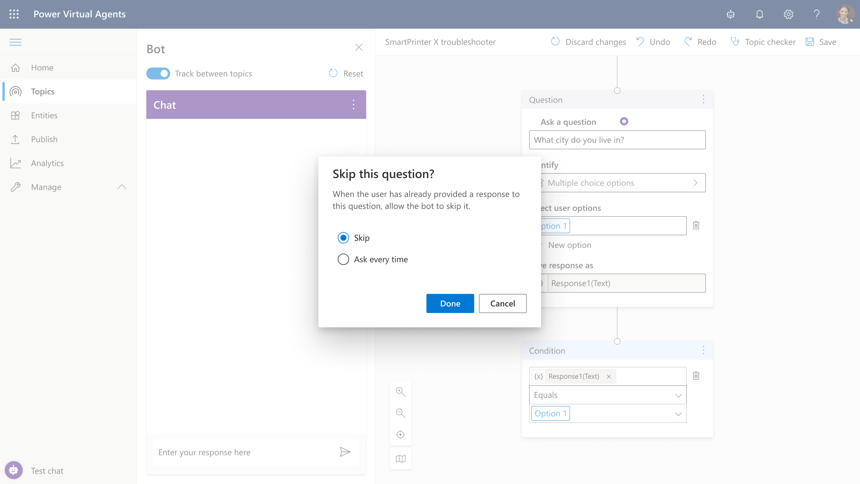
Slot-filling capabilities
Power Virtual Agents can intelligently avoid repetitive conversations
Enhances your efficiency as a maker
Power Virtual Agents can guide you to making the best experience
Notes:
The bot doesn’t follow the dialog script blindly. It intelligently uses all the information it has available to decide when to ask questions and when to skip them.
For example, if the user provided information earlier in the conversation the bot will remember that and skip asking about it again.

Slide 36
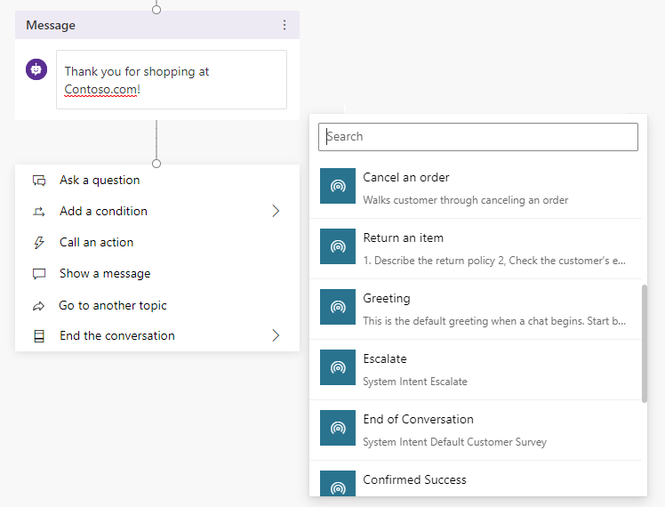
Easily re-direct users to related topics
Re-direct and connect customers to related topics
Power Virtual Agents
Use it when:
A conversation requires more than one topic, such as when you need to ask a clarifying question to determine which topic the user needs
Notes:
You can redirect the conversation to another topic at any point by selecting it from the menu.

Slide 37
Lab 04:
Use variables, topic redirections and entities

Slide 38
Power Virtual Agents + Power Automate

Slide 39
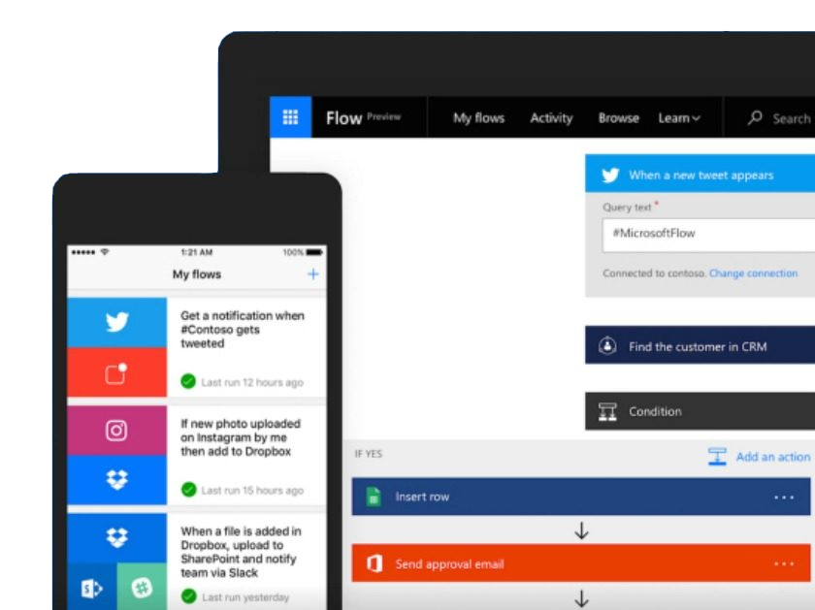
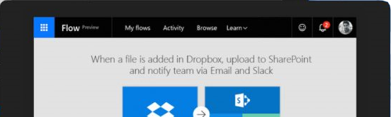
Microsoft Power Automate is an online workflow service that automates actions across
apps and services
Notes:
Power Automate is a SaaS services that helps you work smarter by automating workflow across you’re a growing number apps and services that business users rely on.
The possible workflows span across a wide variety of possibilities, for example :
Get a notifications when a certain file is updated
Synchronize files by connecting your folders to keep data current,
Automatically collect and organize your business data
Streamline approvals and get instant alerts.
Power Automate makes it possible to automate all of these scenarios and more.

Slide 40
A service for automating workflows across apps and services
CONNECT
to data & systems you’re already using, and create the data you need
CREATE
workflows using triggers & actions without code or scripts
EDIT
flows on web and mobile
APPROVE
requests or manage them on web and mobile
Notes:
Power Automate is a SaaS services that helps you work smarter by automating workflow across you’re a growing number apps and services that business users rely on.
The possible workflows span across a wide variety of possibilities, for example :
Get a notifications when a certain file is updated
Synchronize files by connecting your folders to keep data current,
Automatically collect and organize your business data
Streamline approvals and get instant alerts.
Power Automate makes it possible to automate all of these scenarios and more.

Slide 41

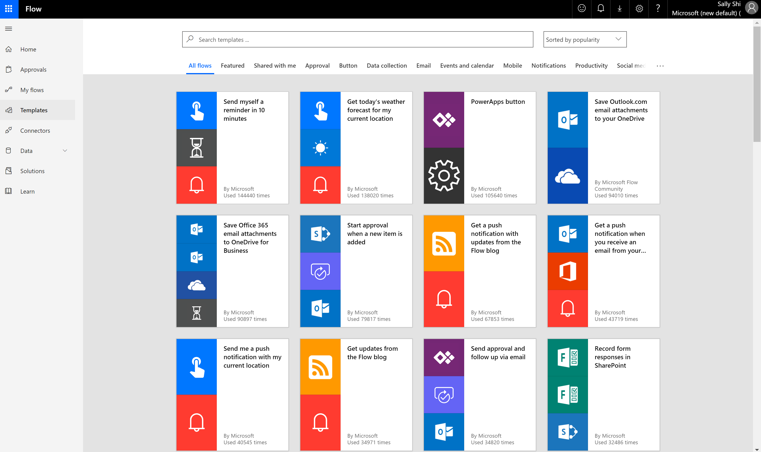
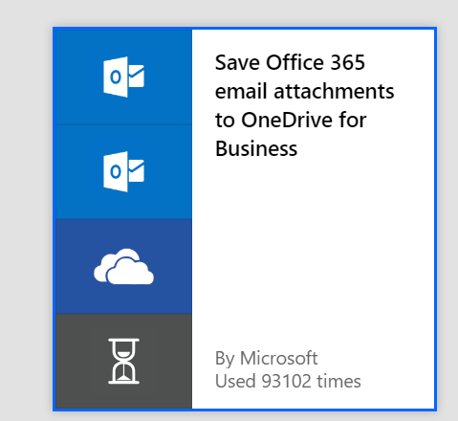
Get started with a growing library of templates
Jumpstart flows using over 100+ templates for common scenarios
Connect services you're already using in more meaningful ways
Notes:
Power Automate has a huge range of templates, which provide you a quick way to get started with commonly used flows and automations, and are also a great way to learn.

Slide 42
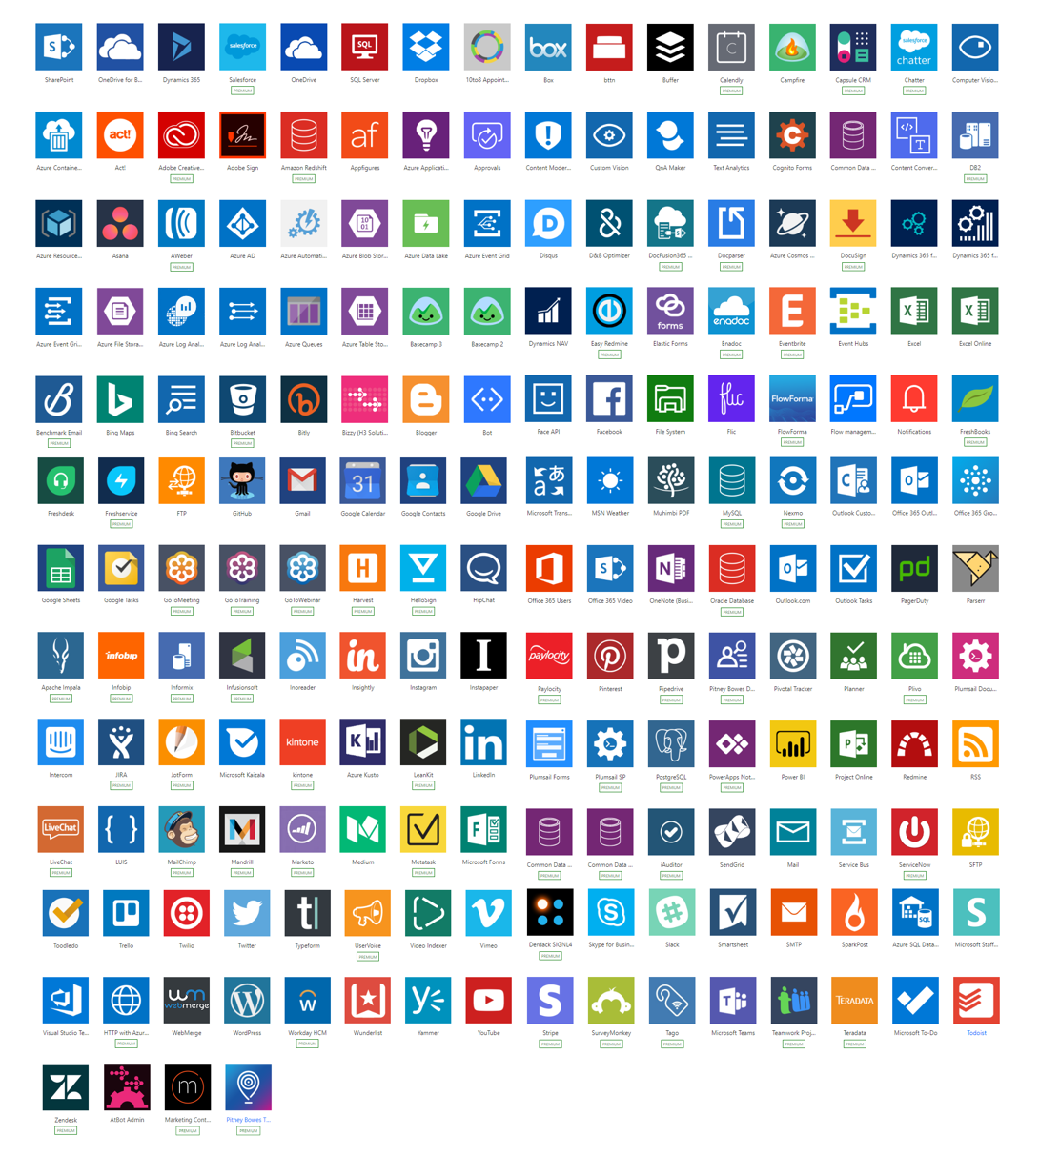
Connectivity & integration
Built-in connectivity to
250+ SaaS cloud services
File providers
Databases
Web APIs
Productivity apps, etc.
Connect to on-premises systems via Data Gateway
Pluggable extensibility via Custom Connectors to integrate existing LOB systems into Power Automate
Notes:
As part of the Power Virtual Agents license you get access to Power Automate. You will get access to over 250 premium connectors, which allow you to connect to third party services in a low-code graphical interface.
You can connect to any third-party service that Power Automate supports. You can read and write data from the database and you can pass data back and forth between the chatbot and Power Automate flow. You also have access to a very convenient HTTP connector in Power Automate which allows you to use your chatbot invoke any third-party API that you might have.
With the UI based flow connector in Power Virtual Agents, you can create flows in Power Automate just for your chatbot and invoke them seamlessly from Power Virtual Agents.

Slide 43
Efficient and secure data integration and storage
Power Automate is built on the Common Data Service
Common Data Service lets you securely store and manage data that's used by business applications.
Dynamics 365
Office 365
Mobile Apps
Web Apps
Power BI
Power Apps
Power Automate
Power Virtual Agents
Microsoft Dataverse
Data connectors
Azure
Notes:
Power Automate is powered by Microsoft Dataverse. Dataverse lets you securely store and manage data that's used by business applications.

Slide 44
Unlock your imagination with Power Automate + PVA
Chatbot uses location-based services (LBS) to provide personalized services
2-factor authentications to increase security
Proactively recommends new promotions, benefits, and better rates to your customers
Check user eligibility and submit applications on their behalf
Remote diagnosis for IOT devices
Make appointments for your customers
Get a picture of the receipt from employee and use Azure AI for expense reimbursement (integration with Azure AI)
Notes:
Using Power Virtual Agents with Power Automate means your bot can do far more than just answer questions – it can take action on behalf of the customer. This can also include working with user authentication tokens, as we will see in the next section.
These are just some of the examples of the huge range of scenarios and use cases that can be enabled by Power Virtual Agents and Power Automate.

Slide 45
Lab 05:
Add a Power Automate flow
Lab 06:
Build a Power Automate flow

Slide 46
Chatbot Authentication

Slide 47
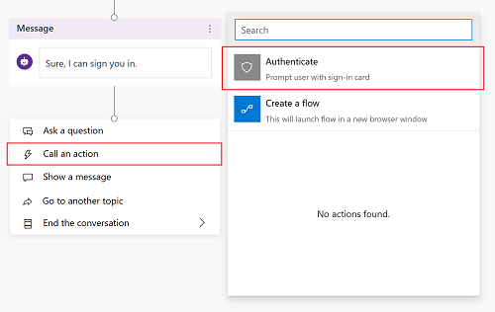
Easily add end-user authentication to your chatbot
Add right from dialogue tree
Call an action
Choose Authenticate
Notes:
Power Virtual Agents allows you to authenticate the user, which allows you to personalize the conversation. Authentication also allows you to skip dialogs in the conversation by prefilling user data and going straight to the point.
You can enable user authentication directly within a chatbot conversation. This means you can prompt a user to sign in using single sign-on, retrieve a user token for that user, and then use that token to retrieve the user's information from a back-end system and enable the chatbot to execute actions on that user’s behalf.
The experience is very flexible. You can mark some parts of the conversation that require the user to log in, while some other parts do not require the user to login.

Slide 48
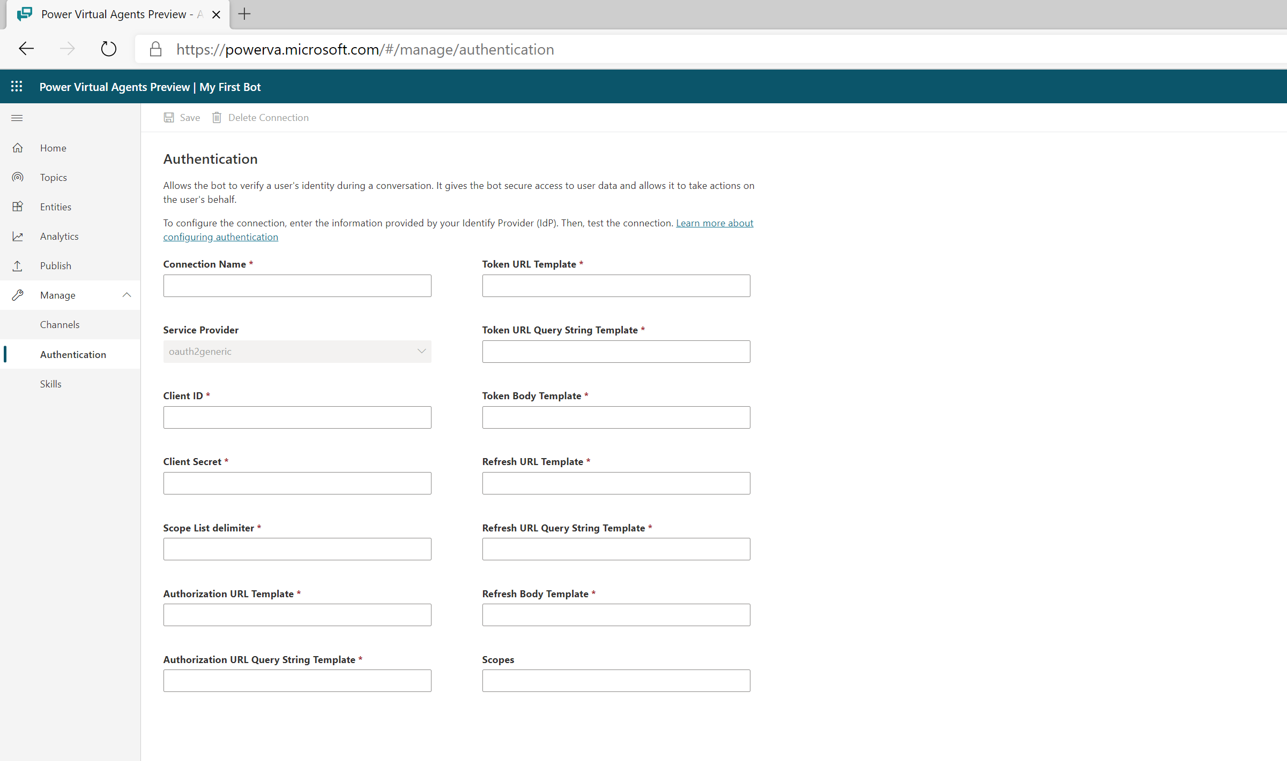
Configure end-user authentication
Add configuration capabilities to your chatbot
Leverage Azure Active Directory
Adheres to OAuth2 standard
Notes:
You can configure a Power Virtual Agents chatbot to provide authentication capabilities, so users can sign in with any OAuth2 identity provider, such as Azure Active Directory (Azure AD), a Microsoft account, Google, Facebook or a custom authentication service that you created for your company.
Power Virtual Agents supports any identity provider that is compliant with the OAuth2 standard

Slide 49
Lab 07:
Authentication

Slide 50
Hand off to support agent

Slide 51
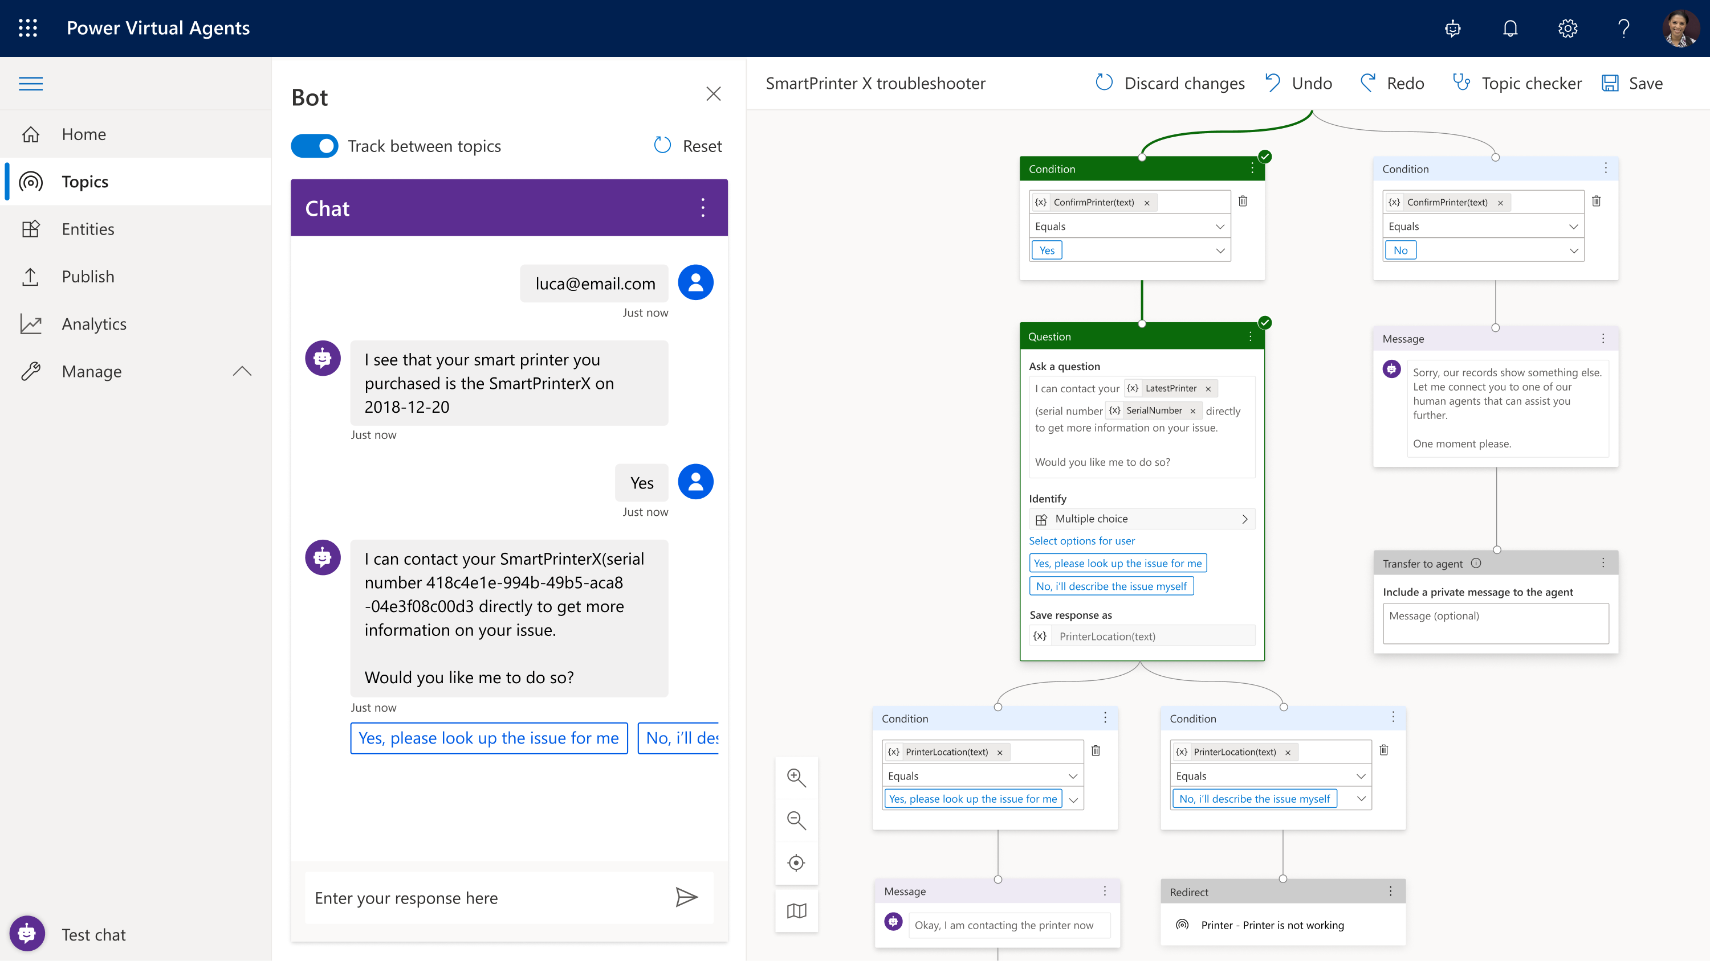
Chatbots and human agents enhance each other
Power Virtual Agents easily partners with your human agents
Leverage the best of both
Create the ultimate experiences for your customers
Notes:
Overview: When a chatbot can’t handle the user’s requests or the user asks to talk to an agent at any point in the conversation, it’s important to gracefully bring in a human. You want to be able to create an experience where the bot can understand it doesn’t have the answer to a question and can transfer to a human agent with the right context. In Power Virtual Agents, you have the ability to configure and connect to multiple live chat engagement hubs.

Slide 52
Configure and connect a chatbot to a human
Hand-off to Dynamics 365 Omnichannel for Customer Service
IT admins can configure hand-off to live chat using Dynamics 365 Omnichannel for Customer Service
Hand-off to generic live-chat provider
IT admins can configure hand-off to live chat using an interface and sample code
Notes:
Dynamics 365 Omnichannel for Customer Service
Power Virtual Agents includes handoff to Dynamics 365 Omnichannel for Customer Service. The customer comes in via the chat in that same environment, interacts with the chatbot, and when the bot doesn’t have an answer or the customer wants to speak to an agent, it can transfer that whole conversation with the context and all information provided for the agent.
Hand-off to generic live-chat provider
Power Virtual Agents also provides handoff to generic live chat providers. IT admins can configure a hand-off from chatbot to other live chat engagement hubs using an interface and sample code.

Slide 53

Dynamics 365 Omnichannel for Customer Service
Productivity
Multisession, Unified, Contextually rich experience for agents & Supervisors with enhanced service management capabilities for routing, work distribution and new productivity tools.
Customer
Channels
Provide personalized service to customers from a channel of their choice – Chat, SMS. Plugin a bot to handle routine requests and free your agents to work on complex issues
Intelligence
Determine customer satisfaction automatically in real time with Sentiment Analysis. Get actionable insights from Interaction trends across channels, Agent performance & utilization data
Agent,
Supervisors
Convenient
Productive
Insightful
Notes:
About Dynamics 365 Omnichannel for Customer Service
Omnichannel for Customer Service is a robust application that extends the power of Dynamics 365 Customer Service to enable organizations to instantly connect and engage with their customers via channels like Live Chat and SMS.
Omnichannel for Customer Service also provides a modern, customizable, high-productivity app that allows agents to engage with customers across different channels. The application offers contextual customer identification, real-time notification, integrated communication, and agent productivity tools like KB integration, search, and case creation to ensure agents are effective.
Supervisors get real-time and historical visibility and insights into the operational efficiency of agents and the utilization across various channels.
The enterprise-grade routing and work distribution engine allows customers to configure agent presence, availability, and routing rules, thus ensuring agents are working on the most relevant engagements.

Slide 54
Exporting and Importing a Chatbot

Slide 55
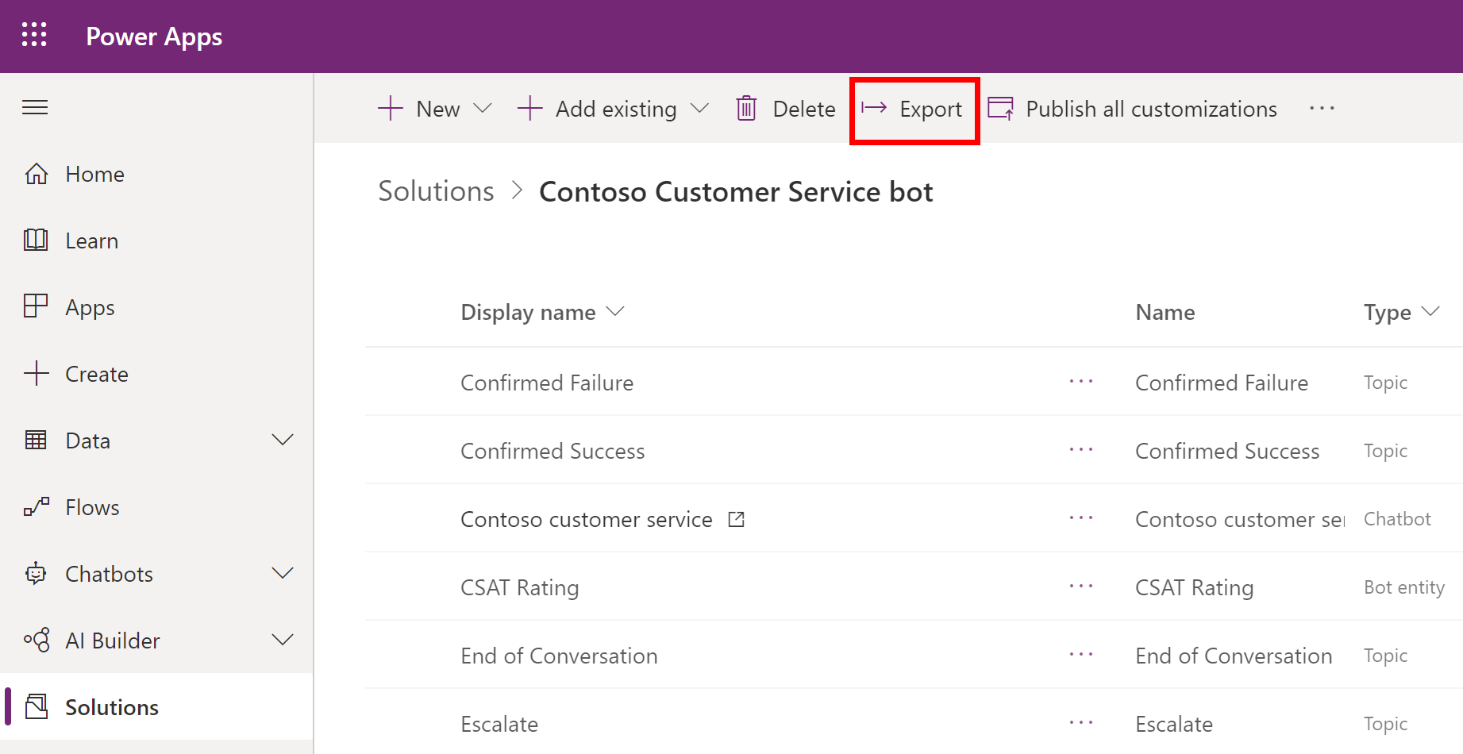

Export and import bots using solutions
Move your bot across multiple environments
Create a solution
Export the solution with your bot
Notes:
You can export and import bots using solutions so you can move your bots across multiple environments. This can be useful, for example, if you have different environments for testing and production, or for a subset of users.
The solution acts as a carrier for the bots, and you use solutions to export the bot from one environment and import it into another.

Slide 56
Lab 09:
Export and import bots using solutions

Slide 57
Power Platform and Teams

Slide 58
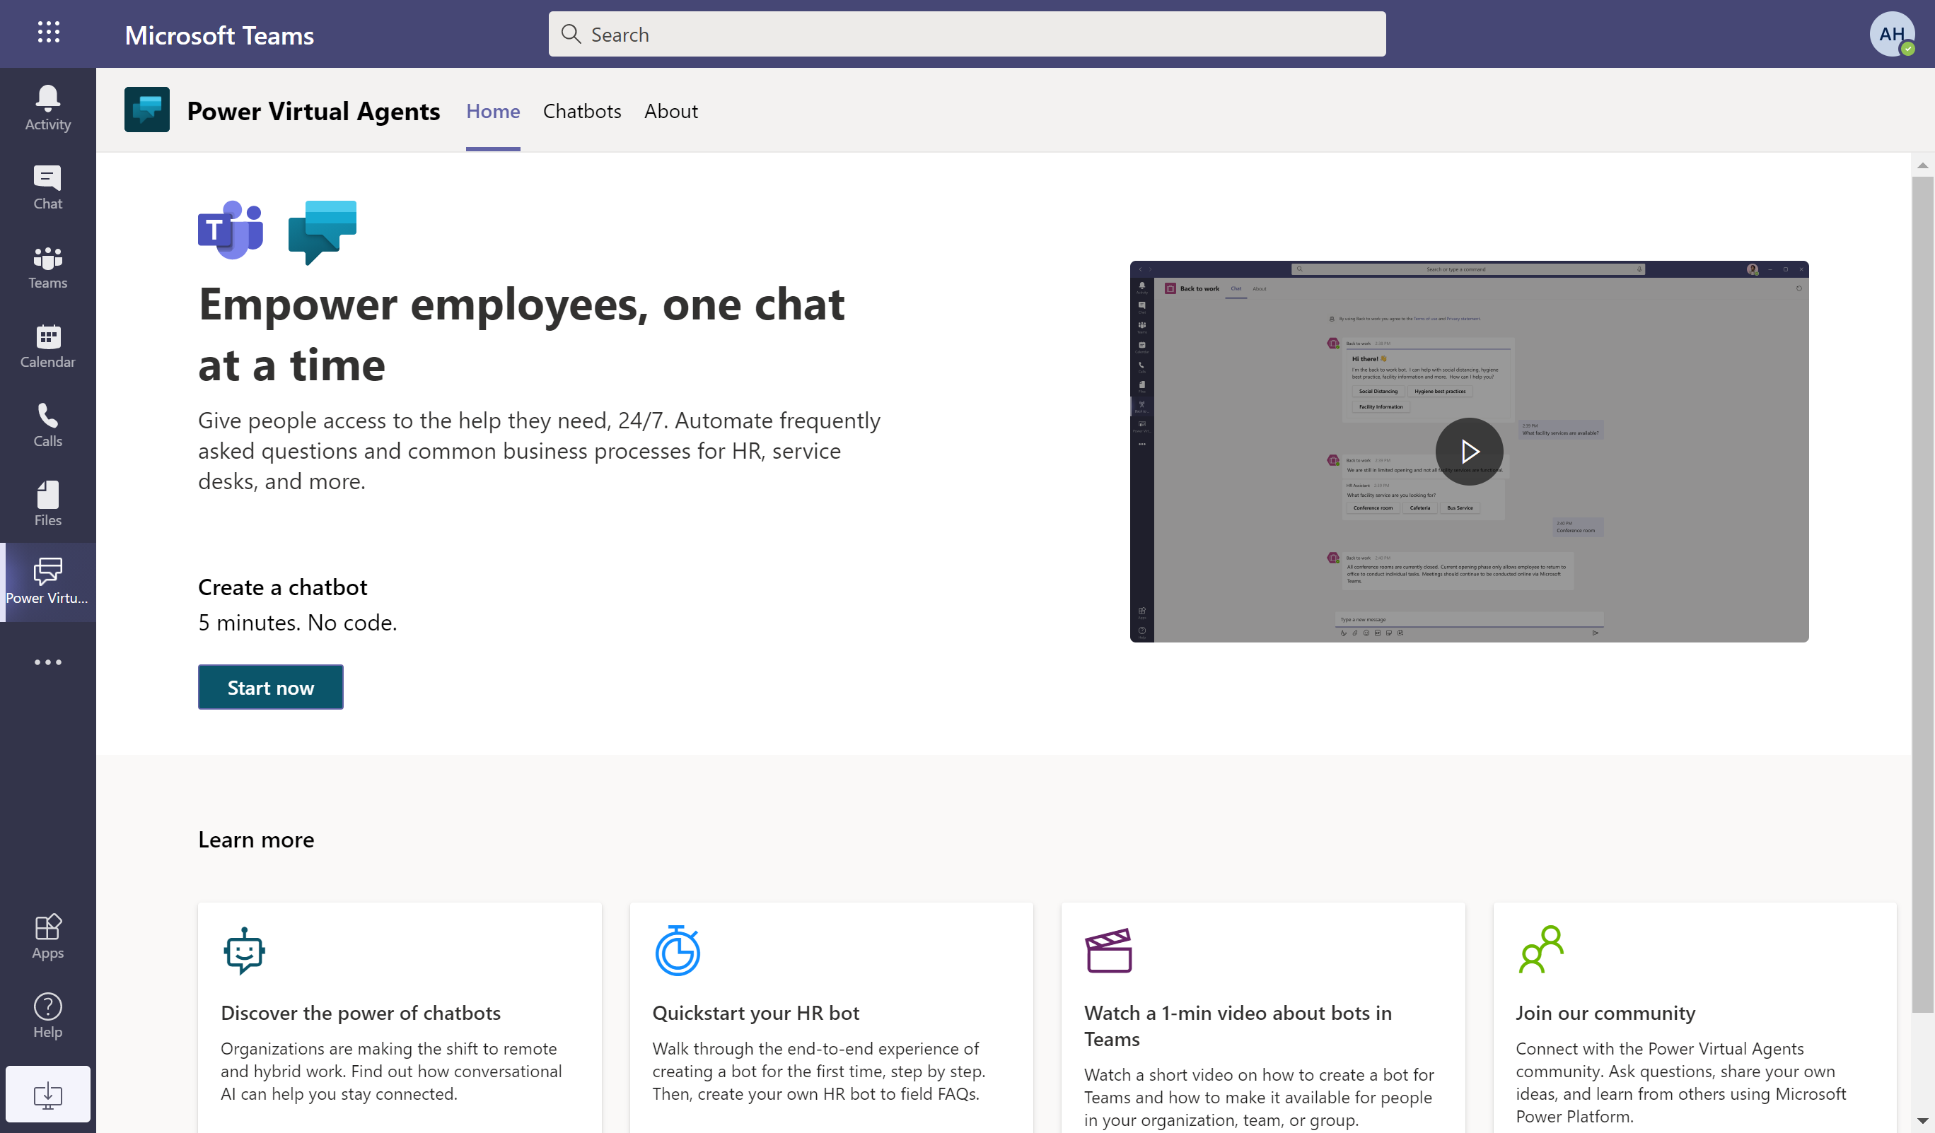

Power Virtual Agents App in Microsoft Teams
Create a bot in Microsoft Teams
Internal bot for employees
Same bot creation experience
Notes:
Power Virtual Agents is available as an app within Microsoft Teams, which means you can easily create your own chatbots that answer questions posed by other employees or team members.
You can add the Power Virtual Agents app from the Microsoft Teams app store and begin to create, author, test, and publish your bot directly into teams, all within the Microsoft Teams interface.
If you want to create a public facing bot for your customers, you will still need to use the Power Virtual Agents web app.

Slide 59
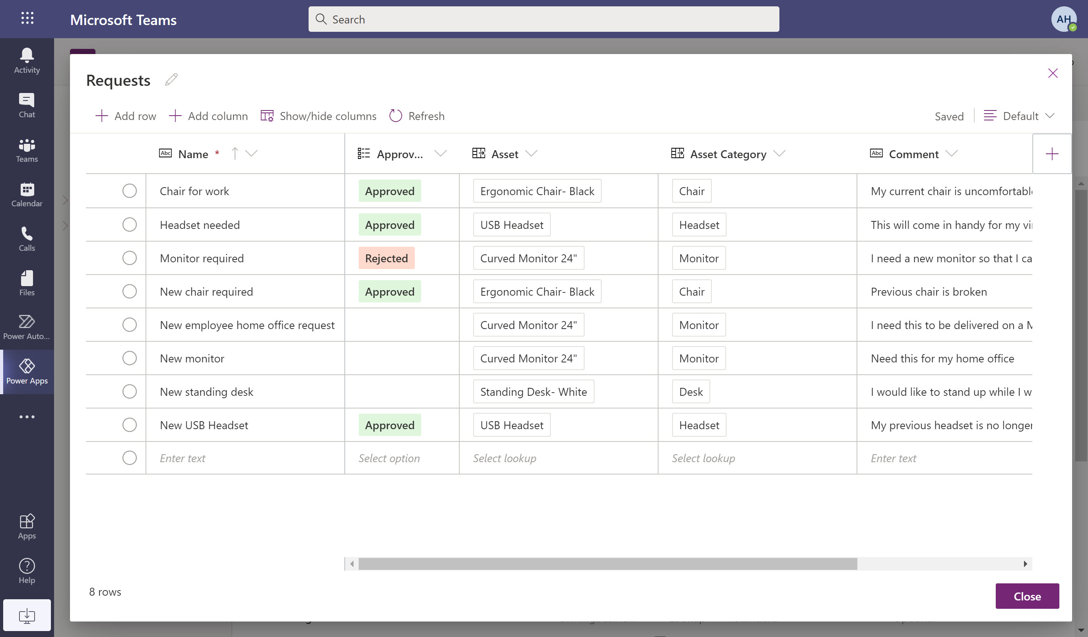

Dataverse for Teams
Teams-tailored version of the relational database behind Dynamics 365 and Power Platform
Provides storage, rich data types with enterprise capabilities
Your chatbot in Teams can connect to this data
Notes:
Dataverse for Teams is a powerful database capability that is now available in Teams, with your existing Teams licence.
It is a slimmed down version of the full Dataverse (formerly known as Common Data Service) which is the back end to the most sophisticated Microsoft Business Applications, including Dynamics 365 which handles massive volumes of mission critical data in the cloud for organizations around the world every day.
Dataverse for Teams takes the essential capabilities of that platform and made it a fully embedded feature and function of Teams.
This enables you to create relational databases inside Teams, and also unlocks other capabilities to build apps, bots and workflows inside Teams without leaving – this is what enables you to build a chatbot inside Teams with Power Virtual Agents.
Your chatbot in Teams can interact with your Dataverse tables – to retrieve rows or create rows on behalf of the user.

Slide 60
Lab 10:
Create a chatbot in Microsoft Teams

Slide 61
Licensing
Power Virtual Agents Licensing and Subscriptions

Slide 62
Which subscription do I need?
Capability | Power Virtual Agents for Microsoft Teams | Power Virtual Agents (standalone)
Channels | Microsoft Teams only | All supported channels
Connect to your data | Standard connectors | Premium and custom connectors On premises data gateway
Chat sessions (Sessions / Tenant / Month) | Unlimited (Teams only) | 2k
Extend your bot with Azure bot framework skills | Not available | Available
 |  | (Power Virtual Agents Viral Trial)
Notes:
Power Virtual Agents for Microsoft Teams vs Power Virtual Agents Standalone.
Channels
PVA for Microsoft Teams – you can only publish your bot in Microsoft Teams. For any other channels (e.g web) the full standalone license is required
Standalone license allows you to publish your bot to all supported channels, including live websites, mobile app, social media and messaging platforms
Power Automate connectors
In both cases the license only includes flows triggered from your chatbot (not standalone flows). Make sure you create a flow from inside PVA as we do in the labs (don’t create from Power Automate first and connect it
PVA for Teams includes use of standard Power Automate connectors, for flows triggered by your bot
PVA standalone includes use of premium and custom Power Automate connectors, for flows triggered by your bot.
Sessions/tenant/month
The count of sessions for PVA Standalone is billed sessions. A billed session is an interaction between the user and the bot – it begins when a user topic is triggered and ends when all the user’s questions or answers (or the conversation exceeds 60 minutes or 100 turns).
Extending your bot with Azure bot framework skills – you must have the full Power Virtual Agents standalone license to use this feature.
*PVA trial gives entitlements to Power Virtual Agents (standalone) full license but is time-limited & doesn't include Dataverse capacity beyond trial environment
Full details: https://docs.microsoft.com/en-us/power-virtual-agents/requirements-licensing-subscriptions

Slide 63
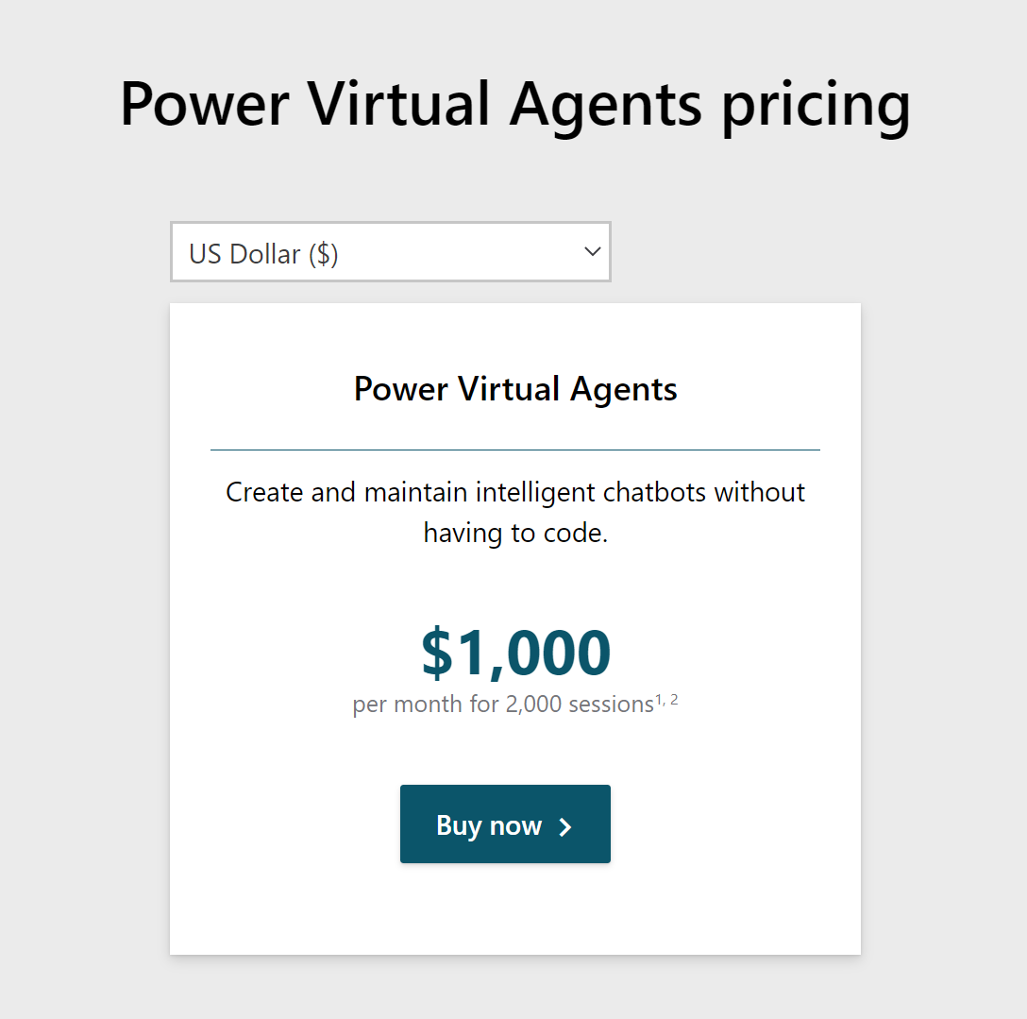


Power Virtual Agents Standalone Pricing
Power Virtual Agents is licensed per tenant, charged by the number of billed sessions
Users who author chatbots need to be assigned a Power Virtual Agent User License
Notes:
Not this price is USD. To get pricing in other currencies see: https://powervirtualagents.microsoft.com/en-us/pricing/
Power Virtual Agents is licensed per tenant and is charged according to the unit of billed sessions. The count of sessions for PVA Standalone is billed sessions. A billed session is an interaction between the user and the bot – it begins when a user topic is triggered and ends when all the user’s questions or answers (or the conversation exceeds 60 minutes or 100 turns).
A user license (called Power Virtual Agent User License) is required for each user authoring bots with Power Virtual Agents. This can be assigned to users by the administrator in the admin portal. The user license SKU is free; you pay for the tenant licence.

Slide 64
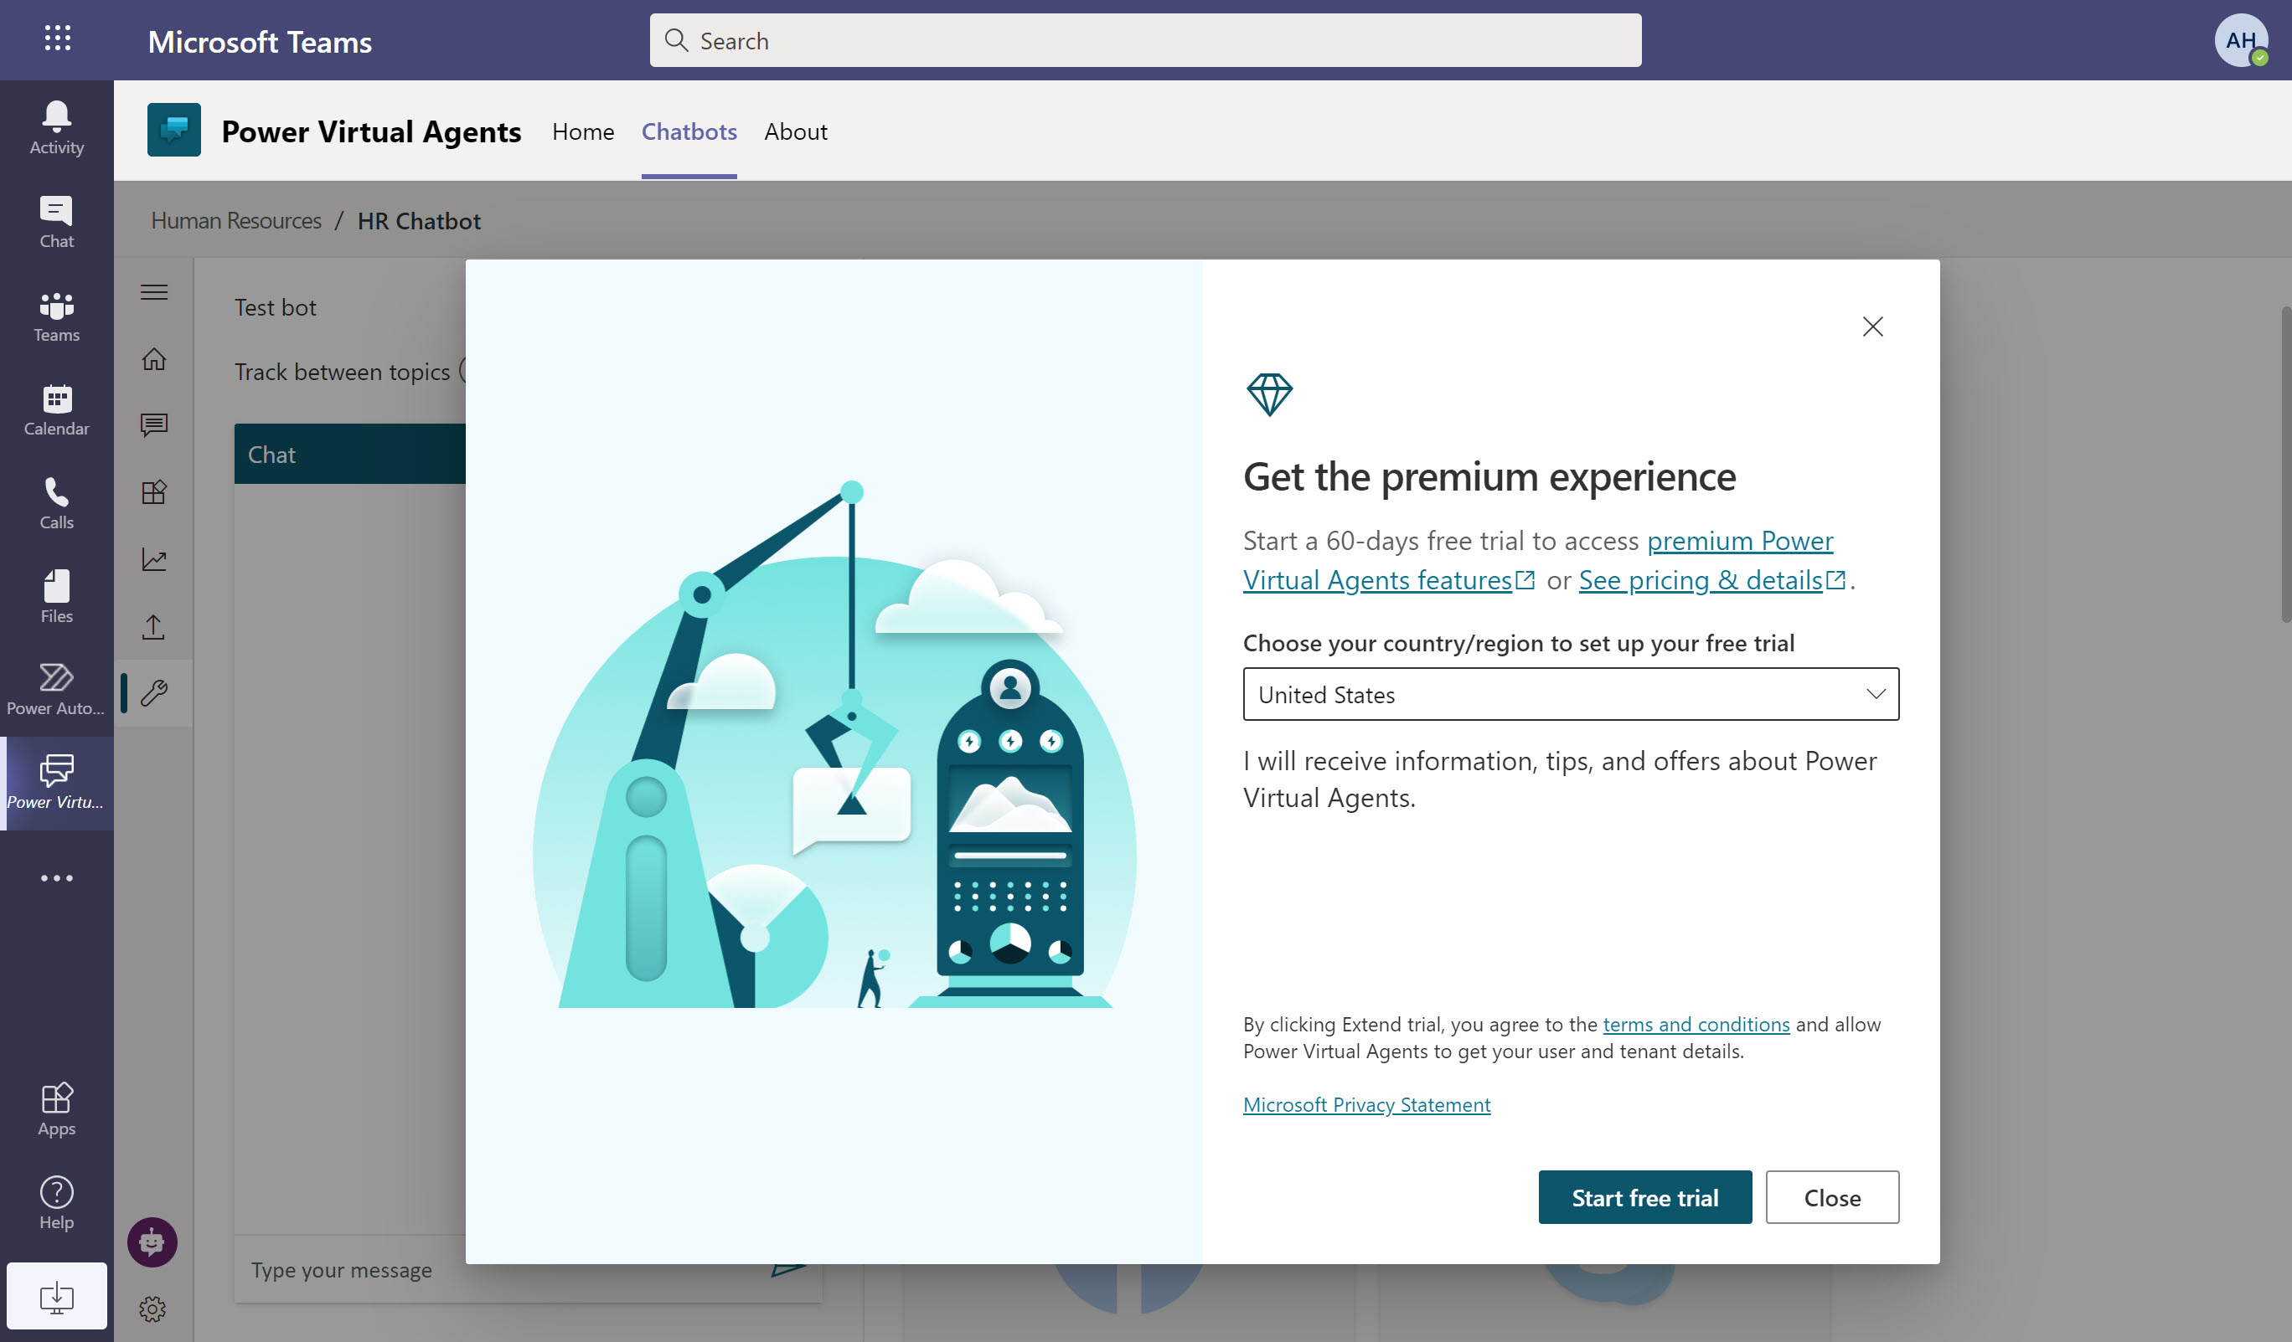

Upgrading your license
Upgrade from within the Power Virtual Agents app for Teams when prompted
Start a free trial of Power Virtual Agents to try all capabilities
Notes:
You can upgrade from Power Virtual Agents in Teams to the full Power Virtual Agents standalone license
If you try to publish your bot to a channel outside Teams, you will be prompted with this message to start a trial, or upgrade to the full subscription.

Slide 65
Chatbot topic design
Notes:
We switch gear a bit here out of lab work and into something different. It’s really important to cover topic design, and these are skills you need to get the most out of your chatbot.
Where we have technology that makes the building easy, the thinking behind how it’s designed and built can make a huge difference to the success of your chatbot.

Slide 66

What makes a chatbot successful?
Knowing your customer
Having accurate, latest and effective content
Knowing when to hand off to a human
Understanding the customer’s request and connecting it to the right topic
Providing personalized, context-aware help, and taking actions for the customer

Slide 67
Types of conversation topics
People use your bot with a specific issue (“topic”) to address or resolve. You can loosely categorize topics into 3 types:
Informational
What is…? When will…? Why…?
Task completion
I want to… How do I…?
Troubleshooting
Something isn’t working right. I got an error message
Notes:
Informational, Task Completion, and Troubleshooting are different types of topics that the chatbot can support. You may also need some topics that are just there to take ambiguous user questions (“I need help” or “shopping”) and ask for clarification so you can then route the user to the correct topic.
When you are considering which business processes to automate, look for the ones with the highest traffic and those where the task can be completed in the chatbot without the need for human involvement. Don’t just replicate what your website can already do – most customers are familiar with websites and will accomplish these tasks themselves without needing to interact with a chatbot. Look to create topics for things which generate a high volume of calls. Build automations for those to start with, and then work on the longer tail of other topics over a period of time.

Slide 68


Designing a topic
Identify the topic
List all scenarios
Design a high-level conversation tree
Design solutions
Validate and iterate on the design
Choose a topic your bot audience will ask about
Focus on high-impact topics first
Put your customer empathy hat on … topic design requires understanding both sides of the conversation
List all possible scenarios
Think about informational needs, task completion, and troubleshooting
Use your favorite tool to draw the conversation tree
What is the fewest number of questions you can ask to understand the situation enough to provide the right solution?
Integrate with Power Automate to personalize and speed issue identification
Make answers clear and concise so users can scan information quickly
Integrate with Power Automate to take action on the user’s behalf
Read the dialog out loud before publishing
Get analytics and read session transcripts for further optimization

Slide 69
Lab 11:
Chatbot topic design

Slide 70
Best practices for writing topic trigger phrases

Slide 71

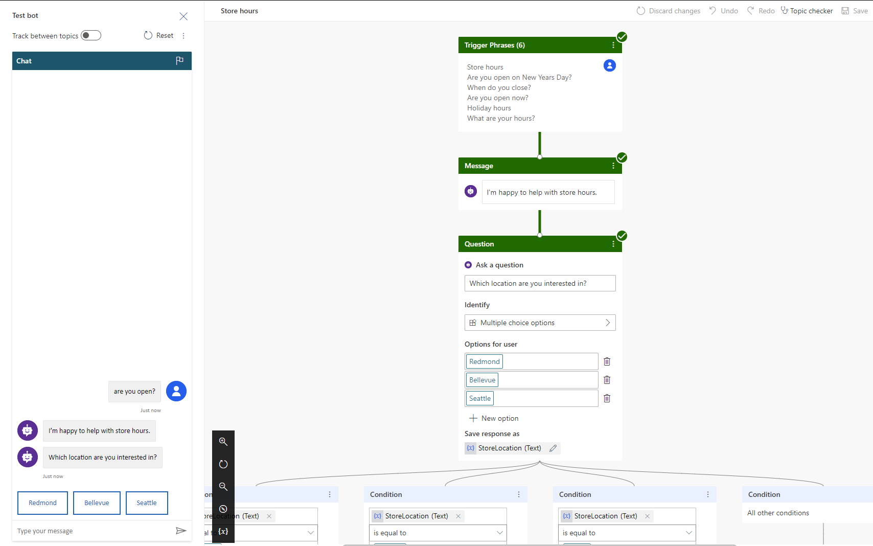
Trigger phrases – Definition
Trigger the chatbot to begin a conversation about a specific topic

Slide 72
Guidelines for better trigger phrase design
Clearly understand the goal and scope of the topic
Make sure the trigger phrases are semantically different
Start with 5 to 10 trigger phrases
Use the words your customers use!
Shorter trigger phrases with fewer than 10 words are generally better
Avoid trigger phrases that are highly ambiguous among different topics
Notes:
Here are some guidelines on writing better trigger phrases to ensure the right topics are triggering.
Trigger phrases should align with the goals and scope of the topic
Writing good trigger phrases using similar words that your end customer will use is very important in building successful chatbots
In order to have the right coverage, ensure you use trigger phrases that are semantically different
Start with 5-10 trigger phrases as you build topics and continue to add variations over a period of time.

Slide 73
Step 1: Pick a topic
Browse Products
Find Products
Special Products – Gift Cards
Refund
Shipment
Fees
Timeframe
“Return an Item”
Return/ Exchange
Pricing
Find a Promotion
Price Match
Member Benefits
Checkout
Delivery
Tax
Tax Calculation
Post-sale
Price Adjustment
Price Adjustment
Payment
Payment Methods
Address
Coupon
Shipment
Order Cancellation
Change/ Cancel Order
Address Validation
Shipping Address
Billing Address
Fraud Check
Order Confirmation
Back Order/Cancellation
Warranty
Order Status

Slide 74
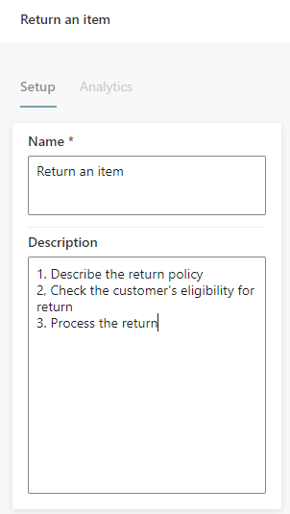
Step 2: Define the goal for the topic
Topic: "Return an item"
Goal:
1. Describe return policy of the store
2. Check customer’s eligibility for return
3. Process the return

Slide 75
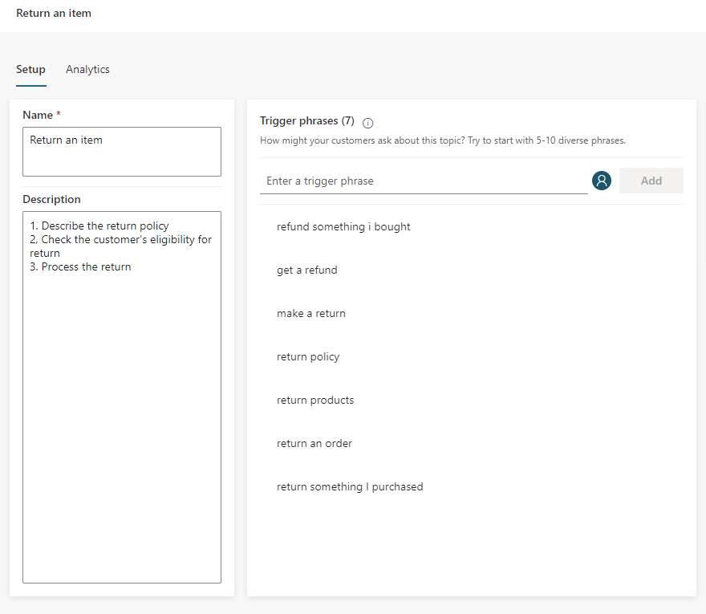
Step 3: Create trigger phrases
Steps:
Start with 5 to 10 trigger phrases. You may need more trigger phrases if the scope of the topic is large
Shorter trigger phrases with less than 10 words are generally better

Slide 76
Step 4: Review trigger phrases 1/3
Steps:
Make sure the trigger phrases are semantically different; using one different noun or verb could be enough to expand a topic’s coverage
Refund something I bought
Get a refund
Make a return
Return policy
Return products
Return an order
Return something I purchased

Slide 77
Step 4: Review trigger phrases 2/3
Adding articles (an, the, etc.), capitalization, contractions, and pluralization has a low chance of improving the triggering
Return some Products
Return Products
Return Product
Return a Product

Slide 78
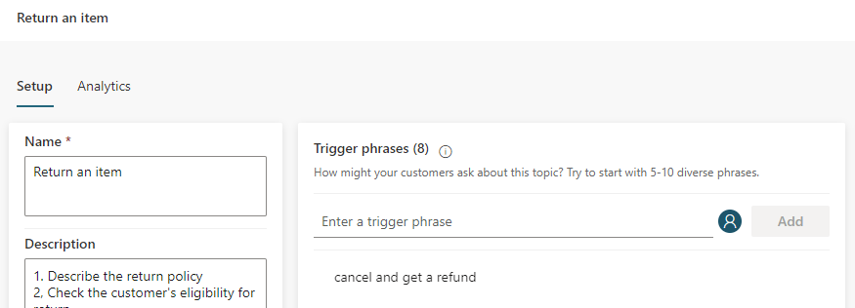
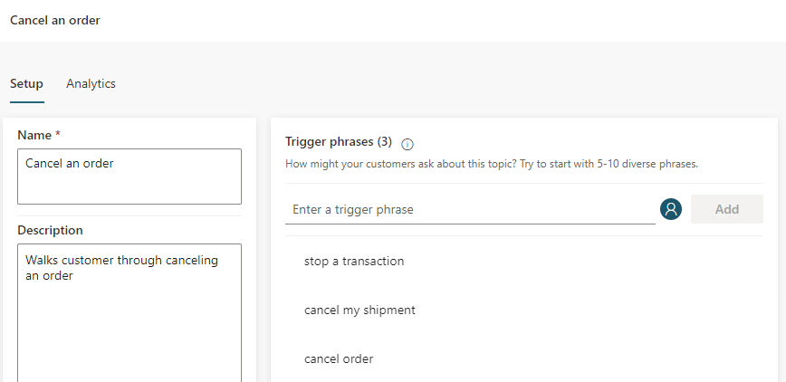
Step 4: Review trigger phrases 3/3
Avoid overlapping trigger phrases or ambiguous trigger phrases among different topics

Slide 79
Quiz time… 1/2

Slide 80

Q1: For the topic “Return an item,” please select the best trigger phrase from below:
A
I want to return an item.
B
My mom was cooking last night when I came back home from school, and suddenly the refrigerator stopped working. Can I return it?
C
I don't like any of the items I purchased from your store.

Slide 81
Answer: A
A is the best because it's direct and simple
B is not good because it is too complicated. It introduces too many irrelevant keywords which could potentially connect to the wrong topics
A
I want to return an item.
B
My mom was cooking last night when I came back home from school, and suddenly the refrigerator stopped working. Can I return it?
C depends on your business logic. If you want to cover this scenario in this topic, then you should add it to the trigger phrases
C
I don't like any of the items I purchased from your store.

Slide 82
Q2: For the topic “Return an item,” please select the good trigger phrases from below:
A
What is your return policy?
B
I want to return my refrigerator.
C
How can I make a return?
D
I want to return an item.

Slide 83
Answer: A, B, C, D
A is good because it is simple and direct. However, you need to make sure your topic covers “return policy”
B is good because it is simple and direct. However, you need to make sure your topic covers “refrigerator”
A
What is your return policy?
C is good because it covers another way to request a return -- use "return" as a noun
B
I want to return my refrigerator.
D is good especially when your store has many items and you cannot list them all
C
How can I make a return?
D
I want to return an item.

Slide 84
Q3: For the topic “Return an item,” here is a sentence from real customer chatlogs.
“I am a member of your store for over 5 years. I was wondering how to return items that I got yesterday. I don’t like the color.”
Write some trigger phrases for it:

Slide 85
Answer:
Step 1: Remove all irrelevant parts, and keep words relevant to the goals of the topic
“I am a member of your store for over 5 years. I was wondering how to return items that I got yesterday. I don’t like the color.”
After that, we can produce 5 good trigger phrases:
1
How to return something that I purchased last week
Step 2: Add new trigger phrases with different keywords
2
How to return something that I bought yesterday
3
How to return products
4
How to return orders
5
How to return items that I got yesterday

Slide 86
Q4: For the “Return an item” topic, which trigger phrases below should you include as a start?
1
I want to return an item
2
I want to return items
3
I want to return two items
4
I would like to return some items
5
I’d like to return an item

Slide 87
Answer: Any ONE of those trigger phrases works
1
I want to return an item
2
I want to return items
Guideline
Adding articles (an, the, etc.), capitalization, contractions, and pluralization has low chance of improving the triggering.
3
I want to return two items
4
I would like to return some items
5
I’d like to return an item

Slide 88
Q5: For the topic “My appliance doesn’t work”, please select the best trigger phrase from below:
A
I want to buy another dishwasher.
B
My freezer doesn’t work.
C
I have a problem.
D
Something is wrong with my appliance.

Slide 89
Answer: D
A is not good because it is not related to the topic at all
B depends on your business logic. If "freezer" is out of your business scope, you should not use it
A
I want to buy another dishwasher.
C is not good because it is too broad. You may want to use another generic topic to handle “I have a problem”
B
My freezer doesn’t work.
D is the best because it is simple and direct
C
I have a problem.
D
Something is wrong with my appliance.

Slide 90
Q6: Below is a sentence from real customer chatlogs. Which topic should we add this trigger phrase to?
Sentence: "My new refrigerator stops working, so I want to return it"
A
Add it to the “Return item” topic.
B
Add it to the “My appliance doesn’t work” topic.
C
We shouldn’t add it to any of these two topics.
D
We should add it to both topics.

Slide 91
Answer: C
Sentence: "My new refrigerator stops working, so I want to return it"
A
Add it to the “Return item” topic.
Answer: C
This is a bad trigger phrase because it's too ambiguous. To avoid confusion, do not add this sentence to either of the 2 topics
The AI model DYM (do you mean) will further clarify with customers and ask them to choose a topic
B
Add it to the “My appliance doesn’t work” topic.
C
We shouldn’t add it to any of these two topics.
D
We should add it to both topics.

Slide 92
Chatbot conversation styles

Slide 93

Qualities of a good conversation
Cooperative
Goal-oriented
Fast
Turn-based
Truthful
Polite
Source: Erika Hall, Conversational Design
Notes:
Good quality conversation styles you need to adopt:
Cooperative: without cooperation between the chatbot and the customer there is no conversation. Conversation flow should be built in a manner that the customer does not need to put in any effort or have any special knowledge or understanding of your design
Goal-oriented: basic principle of conversation design. Every step or turn needs to have a goal in mind. Why is it being asked or shown to the user?
Fast: successful conversations move at a fast past.
Turn-based: It is also critical to provide the right information at the right time and verify that it’s correct before moving forward. Poor interaction requires the participant to backtrack and make corrections, which slows everything down and adds effort to the process
Truthful: Humans have strategies to prevent and resolve misunderstanding quickly in context. Similarly, chatbots should validate information before using it to take action.
Polite: there is nothing as polite as respecting the time of someone who has given you their attention. Politeness can also be achieved by making customers investment of time more productive than expected, for example, by anticipating additional needs before they’ve thought to ask by offering additional choices or fewer choices in a polite manner, depending on the context.

Slide 94
Style: How to sound conversational 1/9
Customer conversations should emulate the best elements of any conversation — personal and polite, friendly and supportive
A few stylistic changes in writing can impart warmth and familiarity to your brand voice
Don’t overuse exclamation points to convey energy. It’s easy to rely on them for this purpose, but too many, in the wrong places, could be interpreted as insincere and robotic
Hey Bryan! Would you like the usual — a large cheese pizza?
So you know, there is a buy-a-large-get-a-small-free deal going on through Saturday. Do you want to try this deal?
Yeah!!
Great! Let me get your order started for you.

Slide 95
Style: How to sound conversational 2/9
Use short sentences
Be positive
Use active voice
Sounds great! Let me get that started for you.
Let’s get started. I have a couple questions. Should only take a minute.
No problem. I can resolve this for you.

Slide 96
Style: How to sound conversational 3/9
I’m going to ask you a couple questions. It should only take a minute.
Good choice. I have a couple suggestions based on what you’ve selected.
Great.
Use contractions: “I’m” instead of “I am.”
Select a pronoun to represent your brand agent in chat and be consistent: “I” or “we.”

Slide 97
Style: How to sound conversational 4/9
Be consistent with tone and style so the conversation sounds like it’s with the same agent and brand
Do
Don’t
Hi there. Welcome to the Store Assistant. I can help you make a return or exchange.
Hi there. Welcome to the Store Assistant. I can help you make a return or exchange.
Let me know at any time if you’d like to chat with a live customer service agent.
If you wish to be in contact with a live customer service agent in regards to your problem, please click the button below.
I want to return an item
Tone shifts to formal
I want to return an item
OK. Could you provide your order number, please?
OK. Provide your order number.
Demanding tone

Slide 98
Style: How to sound conversational 5/9
If you’re using website documentation to answer a question, break sections down into short, scannable graphs
Do
Don’t
How to reset your password: 1. Go to https://account.live.com/password/reset. 2. Select the reason for resetting your password and the alternate contact info where you can receive a security code to verify your identity. Note: This alternate contact info is part of the security info you already added to your Microsoft account.
How to reset your Password If you cannot remember your password, go to https://acount.live.com/password/reset and select the reason for resetting your password. Then include the alternate contact info where you can receive a security code to verify your identity. Note: This alternate contact info is part of the security info you already added to your Microsoft account.

Slide 99
Style: How to sound conversational 6/9
Pace the conversation in short, scannable units
Break up messages into separate, readable blocks to make the pace of the conversation feel more natural
Make sure the chatbot doesn’t respond so quickly that it rushes the customer. Add a minimum delay if necessary
Check in to make sure the user is following the conversation after explaining or answering a question, particularly a complex one
Before we begin, what type of account do you have?
Student
OK, what type of device are you using?
Tablet
Great! First, we need to reset your credentials. I’ll walk you through how to do this.
Open Spotlight by selecting the magnifying glass at the top right of your setting.
Then search for and open CountrySetting.

Slide 100
Style: How to sound conversational 7/9
Maintain a friendly tone when helping to complete the task
Tailor the tone of the chatbot’s responses to the context. If it’s something serious—like billing or cybersecurity—be empathetic but brief and straightforward. If it’s a more mundane situation (like creating a new account), the tone can be more relaxed.
Exclamation points don’t express energy or excitement. Strong writing does, particularly strong verbs. In your desire to help, avoid sounding condescending or insincerely enthusiastic.
Don’t
Hi, I need help with my bill.
Oh! The first step is understanding how your service is billed.
Bills can be complex!
Do
I understand you need help with your bill. Can you tell me in a few words what the issue is?
Charges
Account Settings
Payment

Slide 101
Style: How to sound conversational 8/9
Invite the user into the conversation on a regular basis by asking questions or making suggestions.
Respond to the customer in a timely manner.
If the chatbot may take a while to process the customer’s request, let the customer know what to expect.
Hey Bryan, just checking to see if you still need help with your bill?
Yes sorry
No problem. Do you have your account number, or do you need help finding it?
My account number is 1234567
Thanks! Please wait while I grab your billing info.

Slide 102
Style: How to sound conversational 9/9
Customers abandon a chat when the prompts are lengthy, so keep them brief. To keep your writing simple and straightforward, use the Flesch-Kincaid Grade Level feature in Microsoft Word or an app like Hemingwayapp.com to figure out the grade level for your scripts. In general, the lower the grade level, the better.
What will it be primarily used for?
School
OK. What type of activities will you be using it for?
Homework
Which of these features is most important to you?
Memory
Alright. Here are some options for you…

Slide 103
Lab 13:
Style & the sound of conversation

Slide 104
Instructions
In this session, go through the writing tips and see how the example for each was revised using conversation design principles that you just learned

Slide 105

Tips 1/5
1
Write like you speak
Read your text aloud. Does it sound like something a real person would say? Be friendly and conversational. No. Robot. Words.
Example | Revised
Invalid ID
You need an ID that looks like this: someone@example.com
Notes:
You need an ID that looks like this: someone@example.com

Slide 106
Tips 2/5
2
Use bigger words, fewer ideas
Our modern design hinges on crisp minimalism. Shorter is always better.
Example | Revised
If you're ready to purchase Office 365 for your organization, contact your Microsoft account representative
Ready to buy? Contact us
Notes:
Ready to buy? Contact us.

Slide 107
Tips 3/5
3
Be brief
Give customers just enough information to make decisions confidently. Prune every excess word.
Example | Revised
The Recommended Charts command on the Insert tab recommends charts that are likely to represent your data well. Use the command when you want to visually present data, and you're not sure how to do it
Create a chart that’s just right for your data by using the Recommend Charts command on the Insert tab
Notes:
Create a chart that's just right for your data by using the Recommend Charts command on the Insert tab.

Slide 108
Tips 4/5
4
Get to the point fast
Lead with what’s most important. Front-load keywords for scanning. Make customer choices and next steps obvious.
Example | Revised
Templates provide a starting point for creating new documents. A template can include the styles, formats, and page layouts you use frequently. Consider creating a template if you often use the same page layout and style for documents.
Save time by creating a document template that includes the styles, formats, and page layouts you use most often. Then use the template whenever you create a new document
Notes:
Save time by creating a document template that includes the styles, formats, and page layouts you use most often. Then use the template whenever you create a new document.

Slide 109
Tips 5/5
5
Project friendliness
Use contractions: It’s, you’ll, you’re, we’re, let’s. . .
Example | Revised
To help you avoid traffic, remember anniversaries, and in general do more, Cortana needs to know what you are interested in, what is on your calendar, and who you are doing things with
To help you avoid traffic, remember anniversaries, and in general do more, Cortana needs to know what you’re interested in, what’s on your calendar, and who you’re doing things with
Notes:
To help you avoid traffic, remember anniversaries, and in general do more, Cortana needs to know what you’re interested in, what’s on your calendar, and who you’re doing things with.

Slide 110
Analytics, monitoring and chatbot performance improvements

Slide 111
Understanding the Analytics dashboard
GAIN VISIBILITY OF MANY PARAMETERS
Summary charts
Engagement over time chart
Session outcomes over time chart
Resolution rate drivers chart
Escalation rate drivers chart
Abandon rate drivers chart
Notes:
Power Virtual Agents allows you to measure and constantly improve the performance of your chatbot.
In contains metrics that allow you to measure engagement of customers with your chatbot
It allows you to clearly see how your users are engaging with chatbots over a period of time
You can analyse conversations to better understand how specific topics are performing, what’s impacting your CSAT, and identify areas for improvement
You can clearly see what topics are being resolved, escalated to human agents, and abandoned, and what needs to be rebuilt in the next iteration or what to teach your bot next.
You can’t improve what you can’t measure. So we have a great sense of analytics at the topic level and also about customer satisfaction. Remember these metrics are for the business users. So you can look into the business process and see what’s wrong with a topic or conversation.

Slide 112
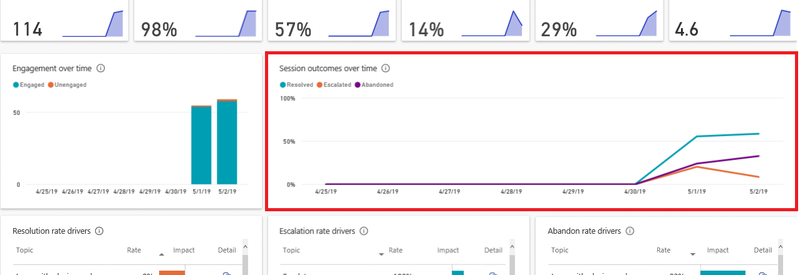
Monitor the ‘Session outcomes over time’ chart for trend changes

Slide 113
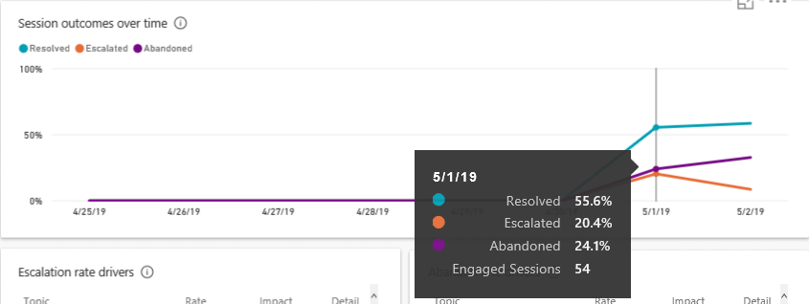
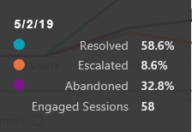
Pay attention to the purple line – Abandon rate is increasing!
Notes:
On 5/1 the abandon rate was 24.1%, on 5/2 it increased to 32.8%. At this point, find out the high abandon rate topic(s) and fix them.

Slide 114
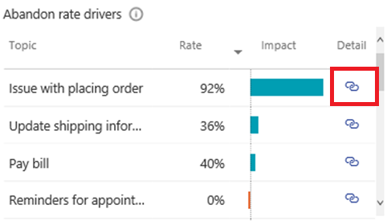
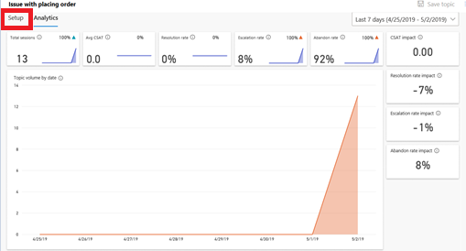
Enter title name here
1. Identify high impact topics driving the abandon rate
2. Find more information about a topic by clicking ‘Detail’
3. Download and read the transcript history for this topic
4. Click 'Setup' to improve the topic content

Slide 115
Quiz time… 2/2

Slide 116
Q1: Which of the following answers is correct?
A
Engagement rate
B
Either Resolution rate or Escalation rate
If abandon rate increases, which rate will decrease?
C
Both Resolution rate and Escalation rate
D
Non-engagement rate

Slide 117
Answer: 1/3
A
Engagement rate
B
Either Resolution rate or Escalation rate
If abandon rate increases, which rate will decrease?
C
Both Resolution rate and Escalation rate
D
Non-engagement rate
Abandon rate + Resolution rate + escalation rate = 1

Slide 118

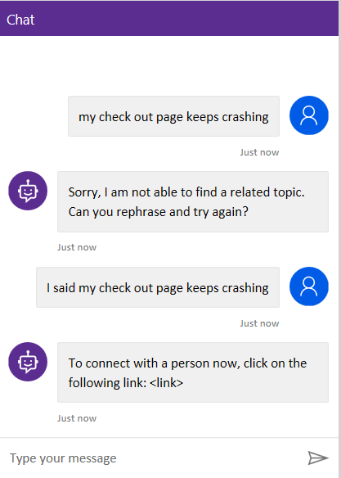
Q2: How would you improve this session?
A
Add new topics
B
Re-design this topic
C
Add more trigger phrases

Slide 119
Answer: 2/3
A
Add new topics
B
Re-design this topic
C
Add more trigger phrases

Slide 120
Q3: Which of the following statements is correct?
A
Adding a good variety of trigger phrases can help increase the resolution rate.
If the user reaches the ‘End of conversation’ but he/she does not respond to the survey, this will decrease the resolution rate.
B
Adding more escalate nodes in the conversation can increase the resolution rate.
C

Slide 121
Answer: 3/3
A
Adding a good variety of trigger phrases can help increase the resolution rate.
If the user reaches the ‘End of conversation’ but he/she does not respond to the survey, this will decrease the resolution rate.
B
Adding more escalate nodes in the conversation can increase the resolution rate.
C

Slide 122
Closing: Wrap up and next steps

Slide 123
The Road Ahead

Slide 124
Coming
Expand reach with support for new languages, channels, and telephony integration
Meet large enterprise needs through better IT manageability: Staging, application lifecycle
Enable chatbots to have more powerful conversations: Using global variables, deeper Dataflex integration, rich responses
Deeper Human + AI collaboration, continually suggesting new topics to automate as the bot gets used

Slide 125

Learn more about Microsoft Power Virtual Agents
Visit Power Virtual Agents to learn more and request a demo
Technical details about the application are available in our help documentation
For questions please engage in our Community forum
Check Power Virtual Agents Blog to learn more best practices and updates

Slide 126
aka.ms/PVAiaDSurvey
Please share your feedback
Lab Survey
Notes:
Please encourage participants to fill out this survey for lab feedback.
We would appreciate your feedback on Power Virtual Agents and on this hands-on-lab, such as the quality of documentation and the usefulness of the learning experience.
Please use the survey at https://aka.ms/PVAiaDSurvey to share your feedback.
You may provide feedback for each module as you complete it or at the end once you’ve completed all the modules. Thank you!

Slide 127
DISCLAIMER
MICROSOFT POWER VIRTUAL AGENTS (1) IS NOT INTENDED OR MADE AVAILABLE AS A MEDICAL DEVICE FOR THE DIAGNOSIS OF DISEASE OR OTHER CONDITIONS, OR IN THE CURE, MITIGATION, TREATMENT OR PREVENTION OF DISEASE, OR OTHERWISE TO BE USED AS A COMPONENT OF ANY CLINICAL OFFERING OR PRODUCT, AND NO LICENSE OR RIGHT IS GRANTED TO USE MICROSOFT POWER VIRTUAL AGENTS FOR SUCH PURPOSES, (2) IS NOT DESIGNED OR INTENDED TO BE A SUBSTITUTE FOR PROFESSIONAL MEDICAL ADVICE, DIAGNOSIS, TREATMENT, OR JUDGMENT AND SHOULD NOT BE USED AS A SUBSTITUTE FOR, OR TO REPLACE, PROFESSIONAL MEDICAL ADVICE, DIAGNOSIS, TREATMENT, OR JUDGMENT, AND (3) SHOULD NOT BE USED FOR EMERGENCIES AND DOES NOT SUPPORT EMERGENCY CALLS. ANY CHATBOT YOU CREATE USING MICROSOFT POWER VIRTUAL AGENTS IS YOUR OWN PRODUCT OR SERVICE, SEPARATEAND APART FROM MICROSOFT POWER VIRTUAL AGENTS. YOU ARE SOLELY RESPONSIBLE FOR THE DESIGN, DEVELOPMENT, AND IMPLEMENTATION OF YOUR CHATBOT (INCLUDING INCORPORATION OF IT INTO ANY PRODUCT OR SERVICE INTENDED FOR MEDICAL OR CLINICAL USE) AND FOR EXPLICITLY PROVIDING END USERS WITH APPROPRIATE WARNINGS AND DISCLAIMERS PERTAINING TO USE OF YOUR CHATBOT. YOU ARE SOLELY RESPONSIBLE FOR ANY PERSONAL INJURY OR DEATH THAT MAY OCCUR AS A RESULT OF YOUR CHATBOT OR YOUR USE OF MICROSOFT POWER VIRTUAL AGENTS IN CONNECTION WITH YOUR CHATBOT, INCLUDING (WITHOUT LIMITATION) ANY SUCH INJURIES TO END USERS.

Slide 128
THANK YOU

